Slide 1




Introduction –
The IOTA-Gynaia Training & Certification programmes
An introduction
Steven Van Vooren, PhD
develop skill
elevate quality
apply actionable insights

Slide 2
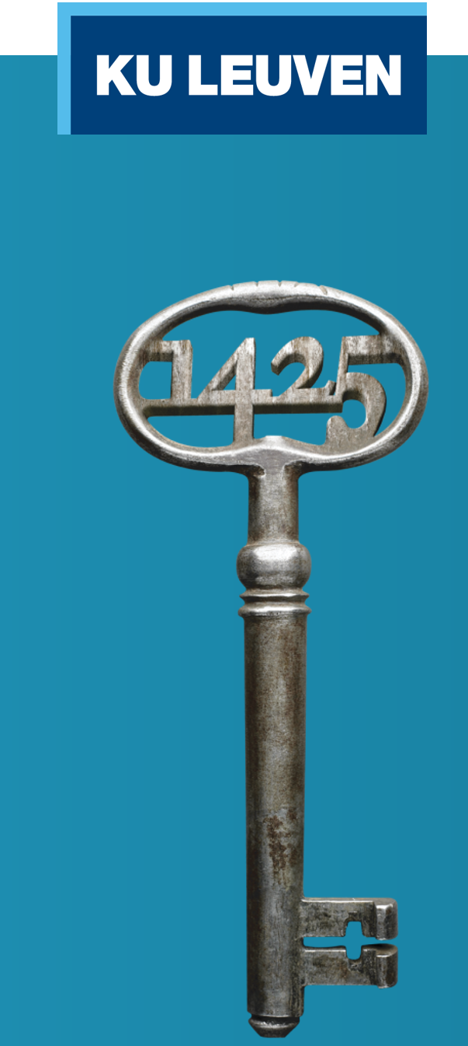


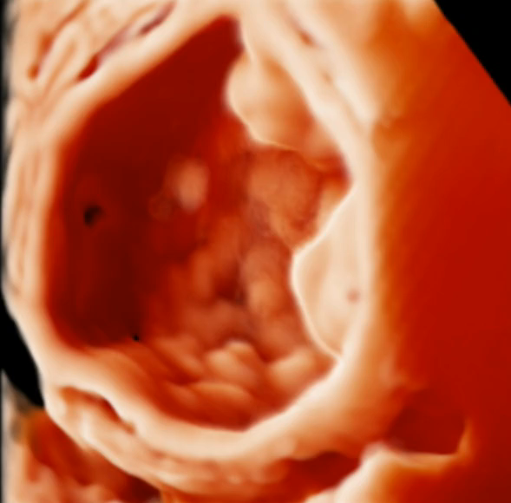
The IOTA project: an introduction
Notes:
15:55-16:20

Slide 3
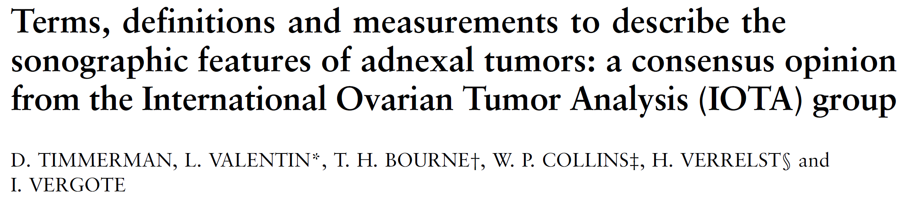

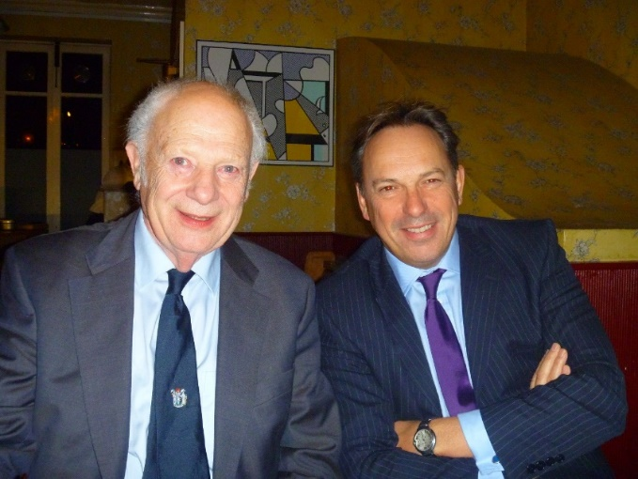


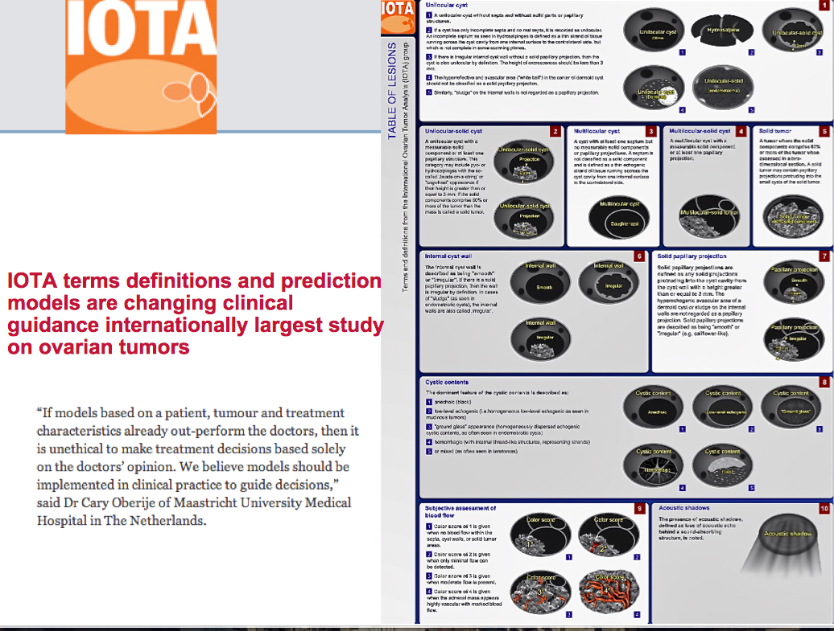
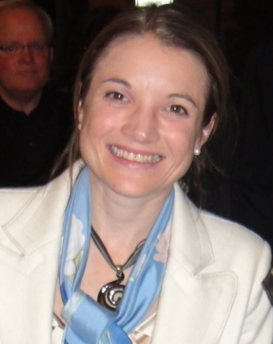
2000
Ultrasound Obstet Gynecol. 2000
Daniela Fischerova
Notes:
The resulting IOTA Terms&Definitions were published in 2000. Later on Daniela Fischerova made beautiful educational material

Slide 4
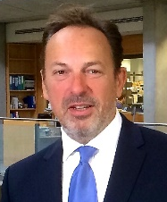

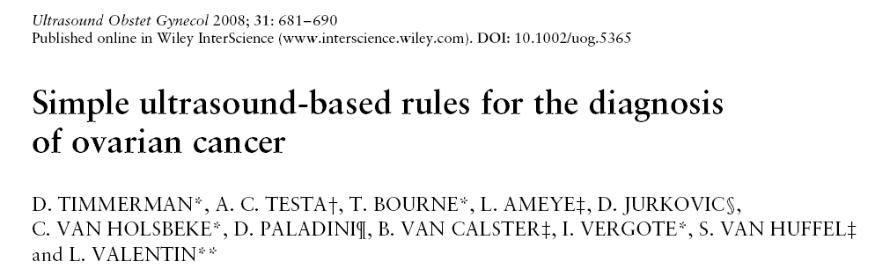

2008
Tom Bourne
Caroline Van Holsbeke
Lil Valentin
Antonia Testa
Notes:
Another landmark paper in the White Journal was the Simple Rules paper. A tumor with malignant features, such as 4 papillary structures and color score 4 and without benign features is classified as malignant and vice versa.

Slide 5


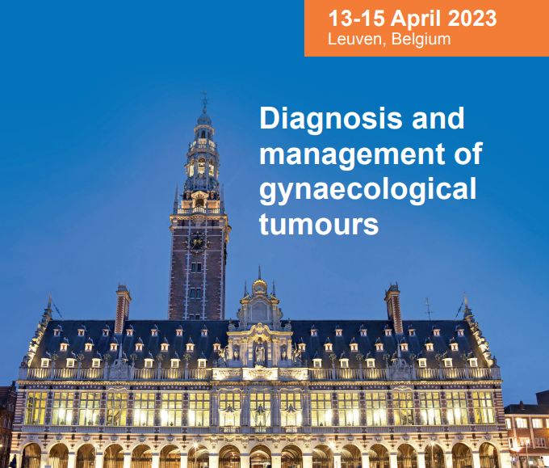
10-12 April 2025
Leuven Belgium

Slide 6
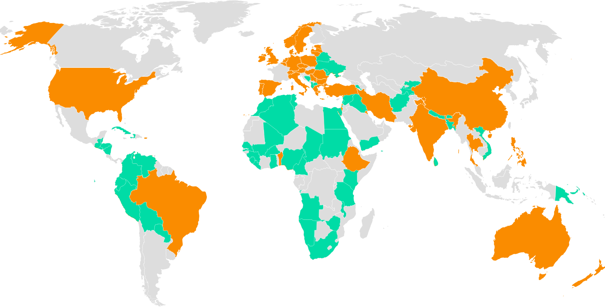
IOTA

Slide 7

IOTA Centers
Hamilton, Canada
Leuven, Tienen, Aarschot, Genk, Belgium
Stockholm, Malmö, Lund, Sweden
London,
UK
Lublin, Katowice, Krakow, Poland
Paris, Maurepas,
Le Chesnay, France
◉
Budapest, Hungary
◉
◉
◉
◉
Athens, Greece
◉
◉
◉
◉
Lisbon, Portugal
◉
◉
◉
TelHashomer
Israel
◉
◉
◉
◉
◉
◉
Barcelona, Pamplona, Spain
◉
Dartmouth, USA
Beijing, China
Caïro, Egypt
Tampa, USA
Prague, Czech Republic
Vienna, Austria
Rome, Monza, Milan, Udine, Naples, Cagliari, Bologna, Florence, Bari, Catania, Cremona, Trieste, Italy
Sydney, Australia

Slide 8
International Ovarian Tumor Analysis
IOTA 1
1999 – 2002
N=1066
IOTA 3
2009 – 2012
N=2403
IOTA 4
2010 – 2013
N=301
IOTA 2
2005 – 2007
N=1938
IOTA 1b
2002 – 2005
N=507
IOTA 5
2012 – 2017
N=14,972
IOTA 6
2017-
Referrals
Prof Testa
Italy
IOTA 7
2017-
‘Real life’
Liquid biopsies
Aim: evidence-based algorithm for management of all ovarian tumors
>35,000 patients included in different studies
>170 scientific papers; 25 PhD (clinical & engineering)
>14,000 certified IOTA members globally
Mission:
positive impact
on clinical practice and
patient care (triage,
waiting times, appropriate interventions)
Research: IOTA-AI (machine learning); Trans-IOTA (liquid biopsies); IOTA-MRI; International consensus; IOTA in pregnancy; IOTA in young patients
Notes:
The IOTA phase 1 study aimed to develop rules and models to characterize ovarian pathology and subsequently their utility was validated by temporal and external validation studies during phase 2 and 3. In phase 3 we also tested new second stage tests. Phase 4 was important to validate them in the hands of less experienced examiners. Finally IOTA 5 also included non-operated tumors to investigate to what extent unnecessary operations could be avoided.

Slide 9
2014

Slide 10
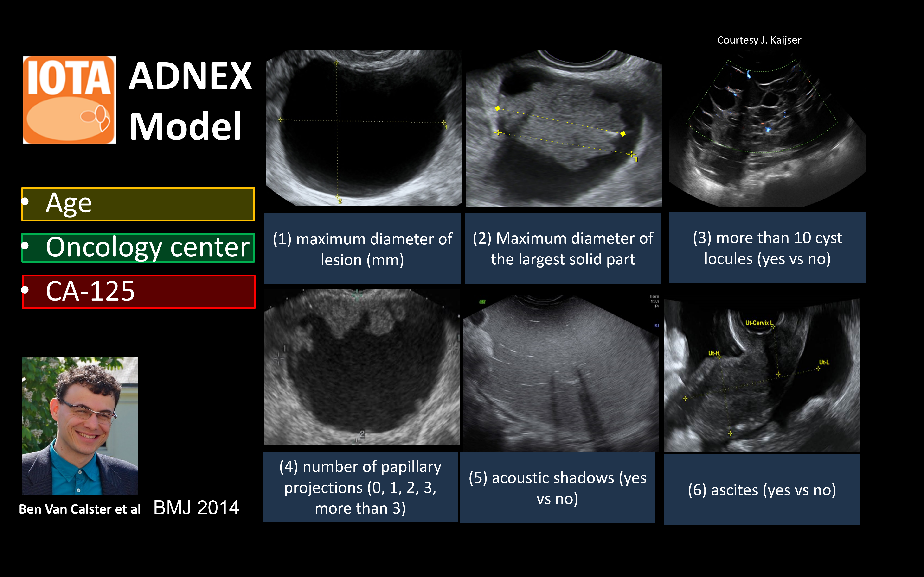
2014

Slide 11

External validation studies of ADNEX: systematic review
2024
Region | Studies | Centers | N | Countries
Asia | 21 (49%) | 32 | 6067 | China, Korea, Turkey, Iran, Philippines, Taiwan, Thailand, Vietnam, Indonesia
Europe | 17 (40%) | 49 | 8504 | Italy, Poland, UK, Sweden, Spain, France, Lithuania, Belgium, Czech Republic, Germany, Greece, Netherlands, Romania
South America | 3 (7%) | 3 | 447 | Brazil, Colombia, Venezuela
North America | 2 (5%) | 2 | 412 | Canada, USA
TOTAL | 43 | 86 | 15430
Barrenada et al. BMJ Medicine; 2024; 3(1) 2024 Feb 17

Slide 12
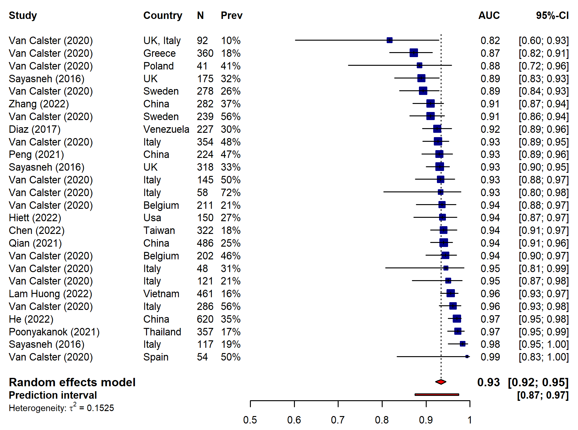
External validation of ADNEX without CA125: a meta-analysis
Barrenada et al. BMJ Medicine 2024; 3(1) 2024 Feb 17

Slide 13
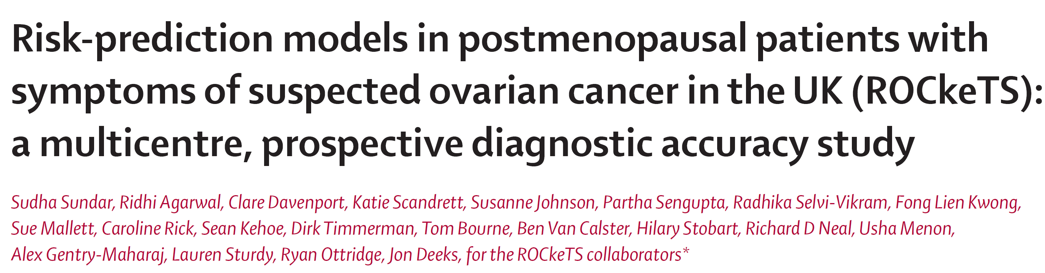

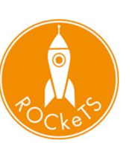
www.thelancet.com/oncology Vol 25 October 2024
23 hospitals in the UK
1242 postmenopausal patients were recruited, of whom 215 (17%) had primary ovarian cancer

Slide 14



Case for change – only 2.9% of women referred from primary care through urgent suspected gynaecological cancer pathway receive a cancer diagnosis
Robust multicentre evidence that structured ultrasound using IOTA ADNEX model triage does:
1) identify cancer accurately
IOTA ADNEX AUC to distinguish benign from malignant tumours 0.93; 95%CI 0.92-0.94
2) identify low risk patients < 1% risk of cancer
Landolfo C et al. Benign descriptors and ADNEX in two-step strategy to estimate risk of malignancy in ovarian tumors: retrospective validation in IOTA5 multicenter cohort. Ultrasound Obstet Gynecol. 2023 Feb;61(2):231-242. doi: 10.1002/uog.26080. Epub 2023 Jan 12. PMID: 36178788; PMCID: PMC10107772.
High anxiety levels ( Kwong et al, BJOG 2024)
High unnecessary 'suspected cancer' operations – 65% in ROCkeTS trials (Sundar et al, Lancet Oncology 2024, BMJ, in revisions 2025)
Multicentre study - 37% of ovarian masses triaged as low risk (1798/4905)
Associated risk of malignancy <1% over 2 years
With Conservative management, risk of complications <1%

Slide 15
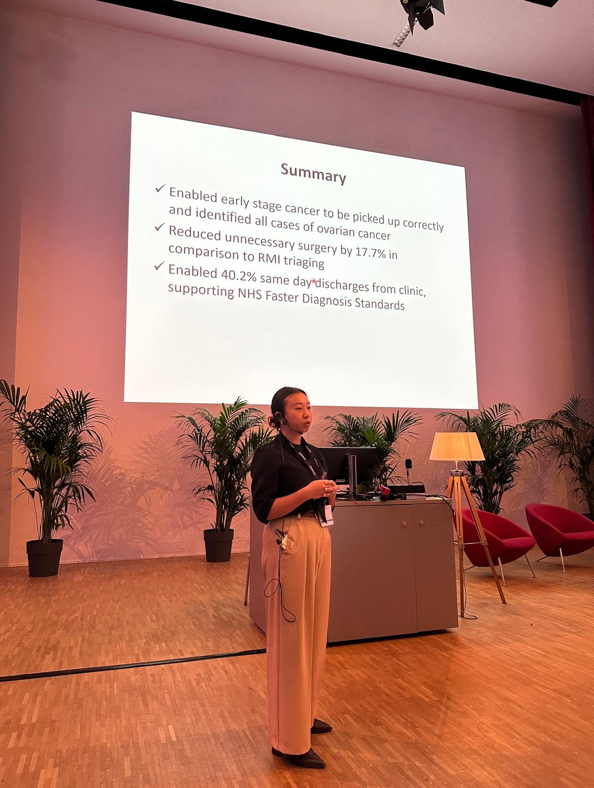
3) reduce 'suspected cancer' surgery rates - Implementation of IOTA ADNEX 2-step strategy in a ‘one-stop’ clinic model across 2 NHS Hospitals in the West Midlands
334 patients referred from primary care- 13 OC cases diagnosed based histology with all invasive OC identified correctly following IOTA ultrasound.
55% (169/306) duplicate ultrasound in secondary care due to inadequate initial evaluation
42% (139/334) same day discharge rate
20-percentage point reduction in surgery rate with IOTA-ADNEX guided management compared to RMI at 250 threshold ( 55/306 (18% ) with IOTA ADNEX triage vs 117/306 (38%))
High satisfaction - 93% patients rated the service ‘very good’ overall
Vivian Do, IOTA Congress, April 7, 2025

Slide 16
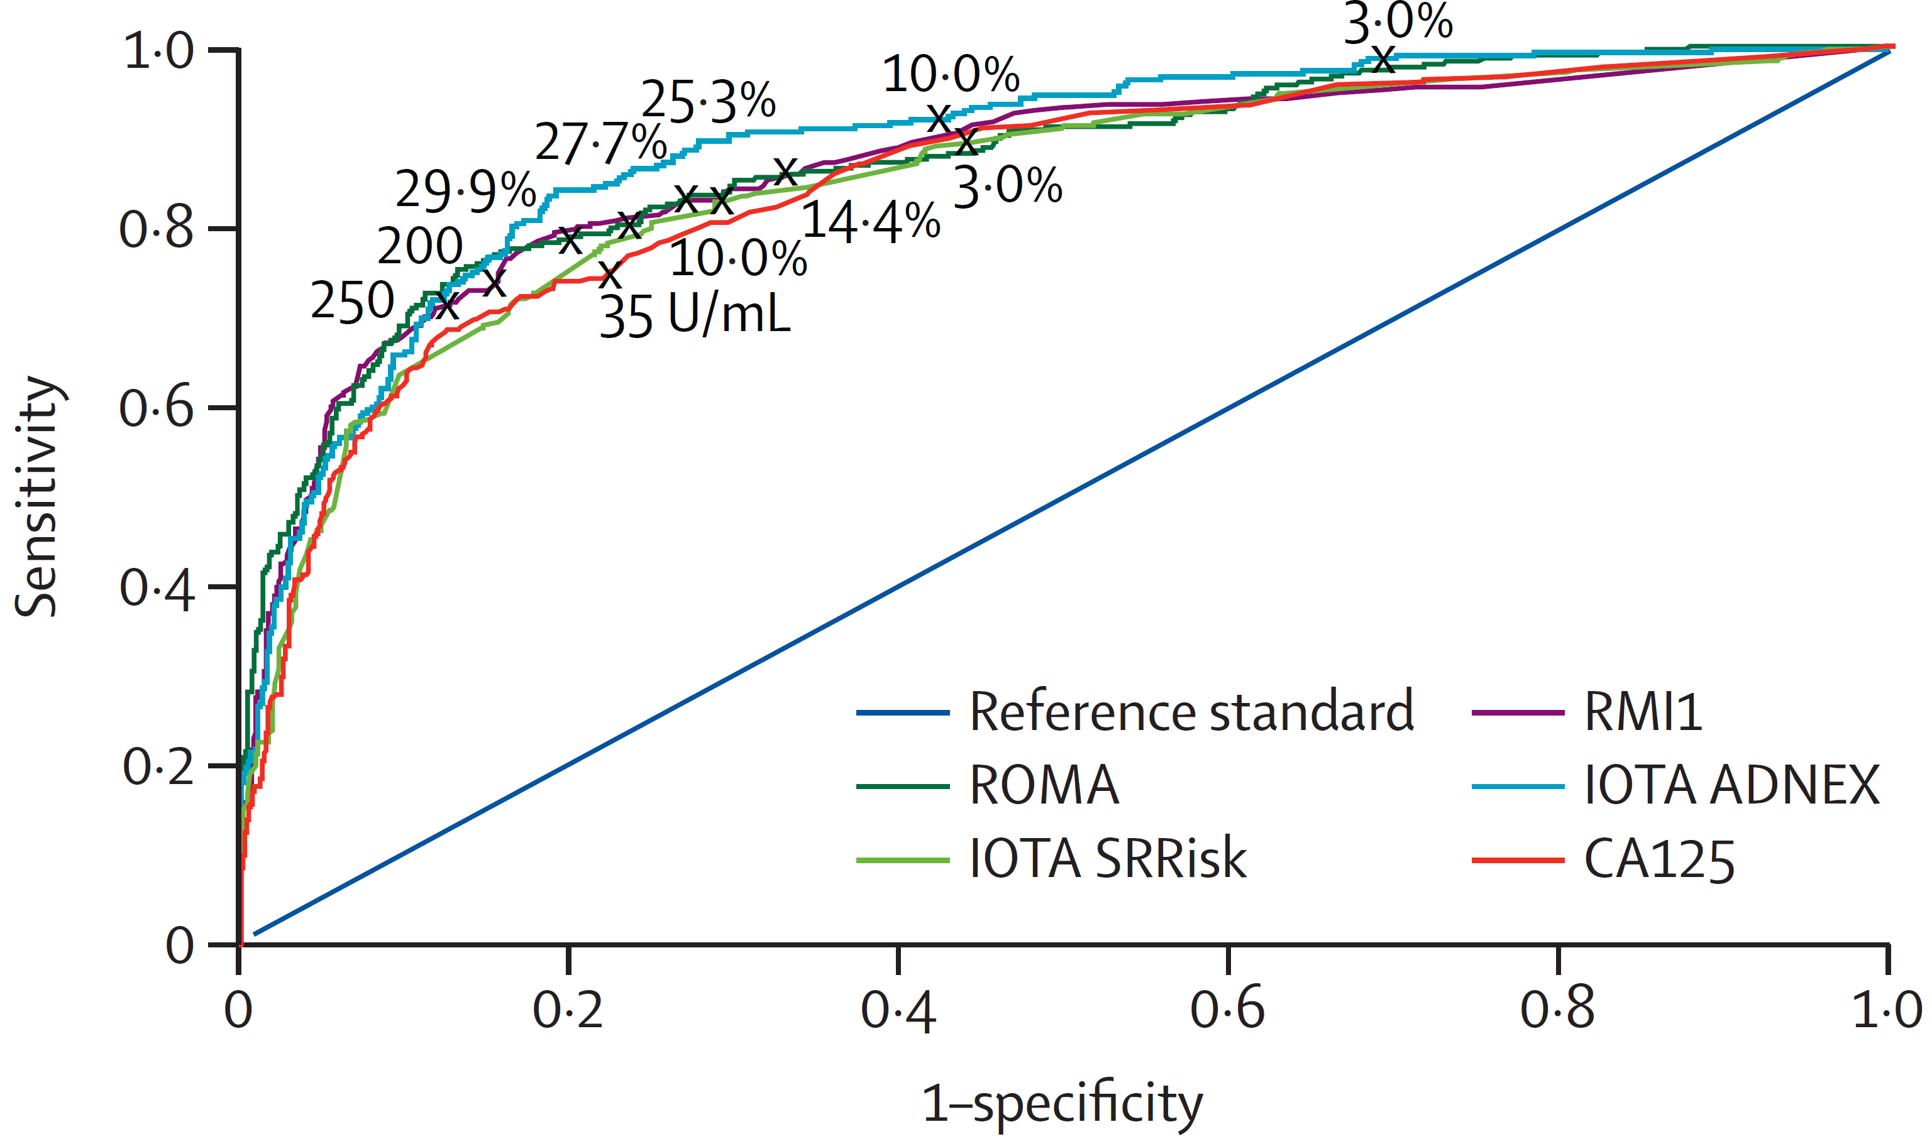
www.thelancet.com/oncology Vol 25 October 2024
We recommend that IOTA ADNEX at 10% should be considered as the new standard-of-care diagnostic in ovarian cancer for postmenopausal patients

Slide 17
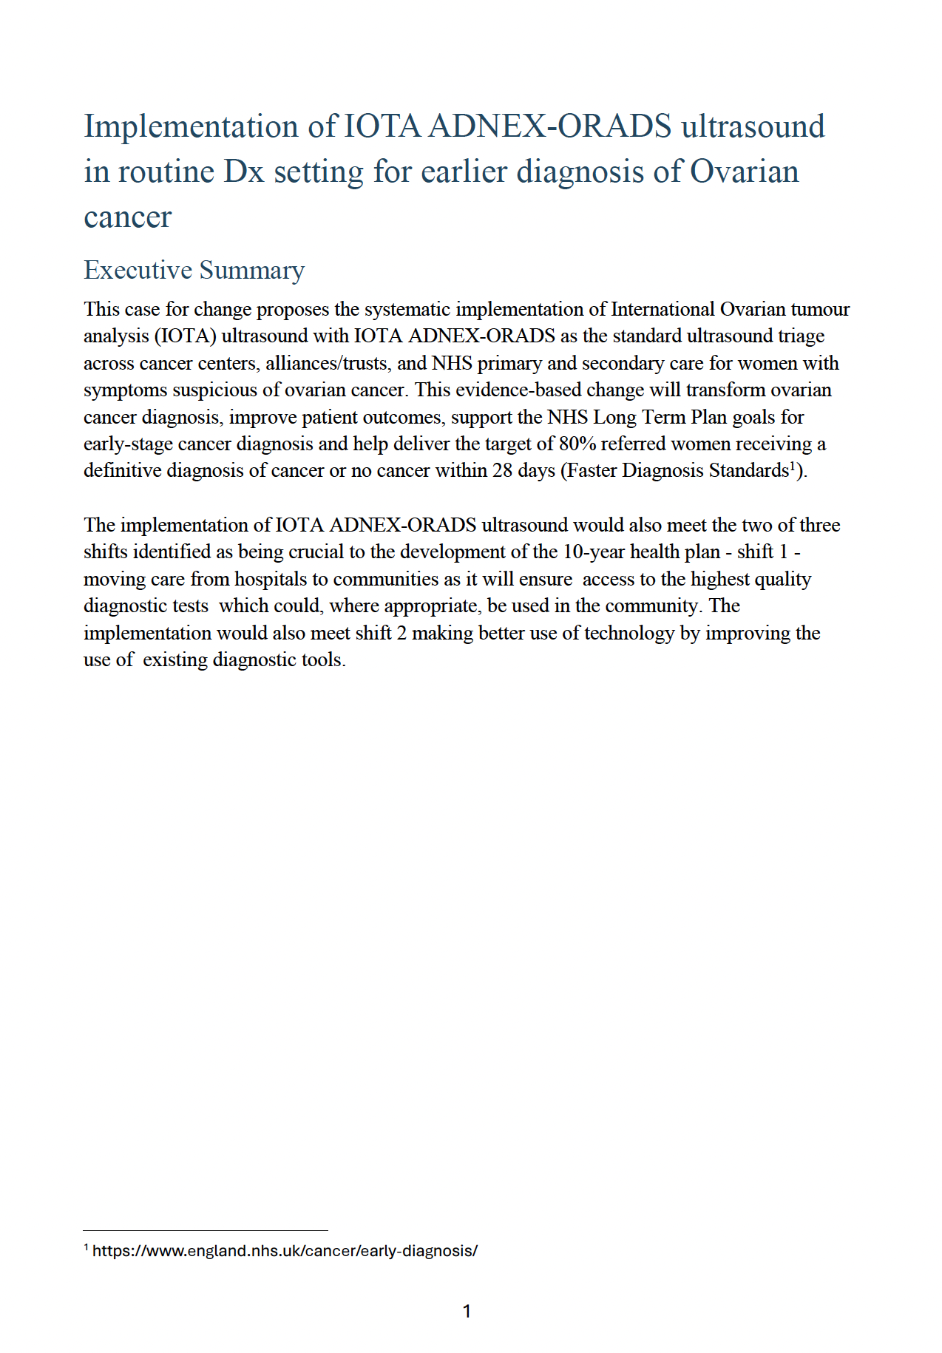
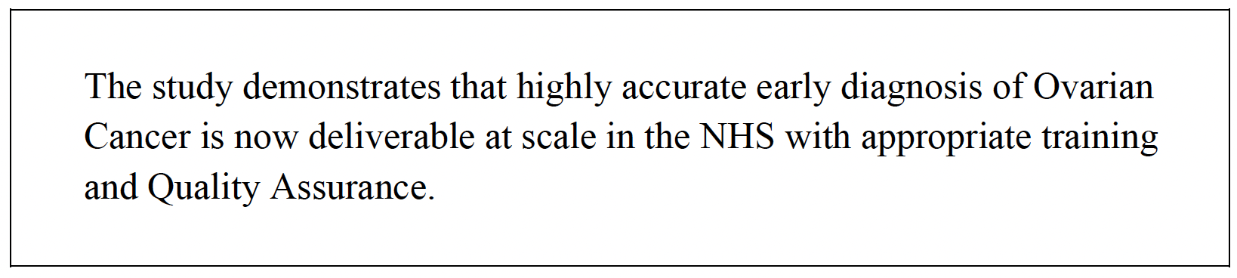
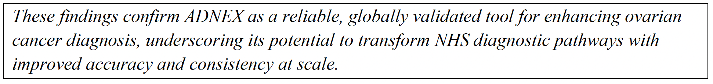
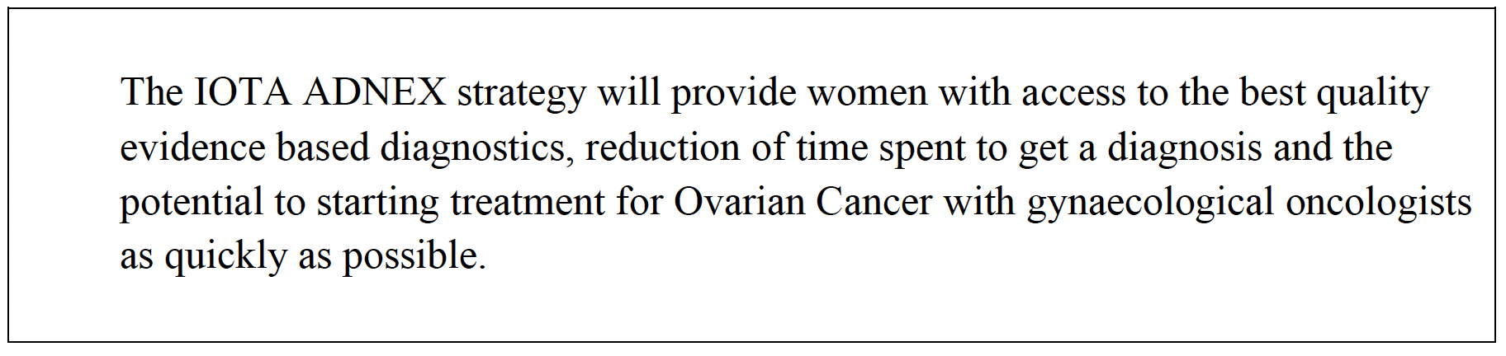
The investment in training and quality assurance will be offset by improved diagnostic accuracy, more appropriate referrals, delivery of faster diagnosis standards, reduction in wait lists, and ultimately, better survival rates for women with ovarian cancer.

Slide 18
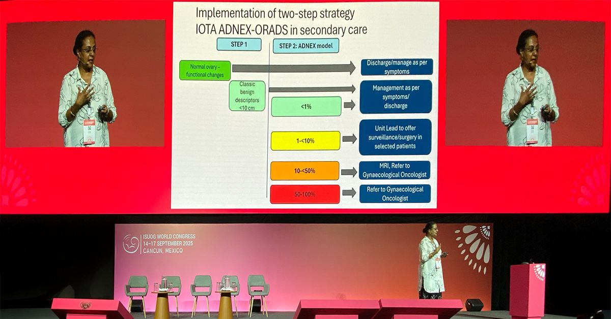
“Valuing sensitivity over specificity, IOTA ADNEX at 10% in real-world practice has highest sensitivity and should be considered the new standard of care diagnostic test in ovarian cancer for postmenopausal women.”
NICE guidelines (2026) expected to replace RMI w. ADNEX

Slide 19
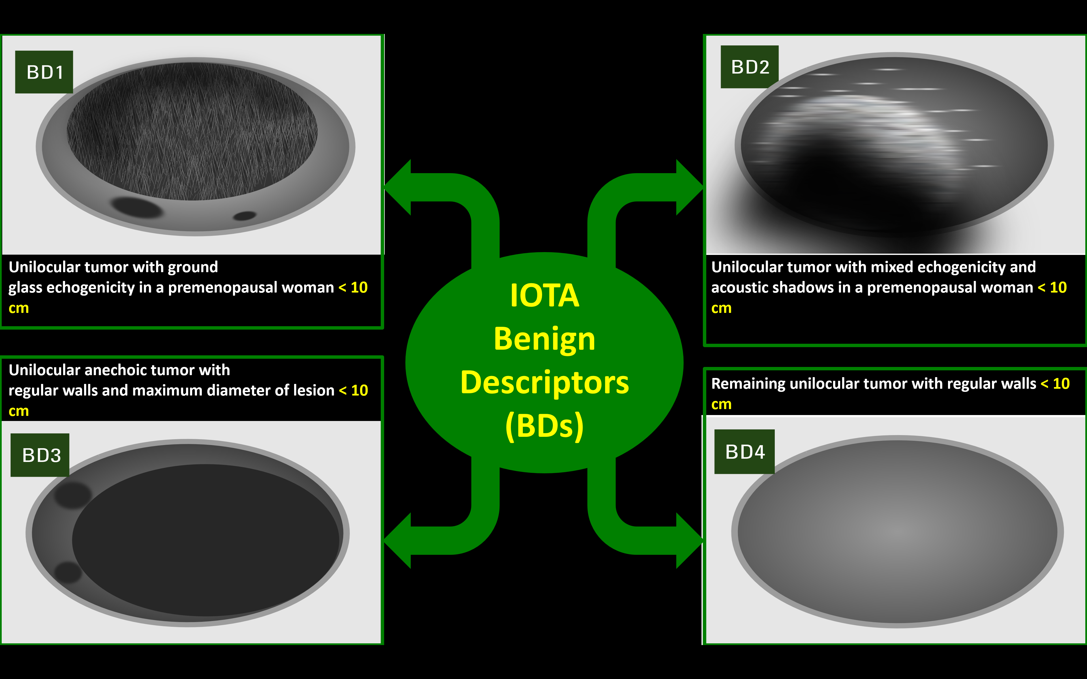
IOTA 2-step strategy
All patients (n=4905)
Step 1
Benign descriptors (BD) (n=1798) (37%)
BD: 99.3% benign
Step 2
ADNEX model (n=3107) (63%)
AUC 0.94
(Landolfo et al. Ultrasound Obstet Gynecol, Sept 2022)

Slide 20

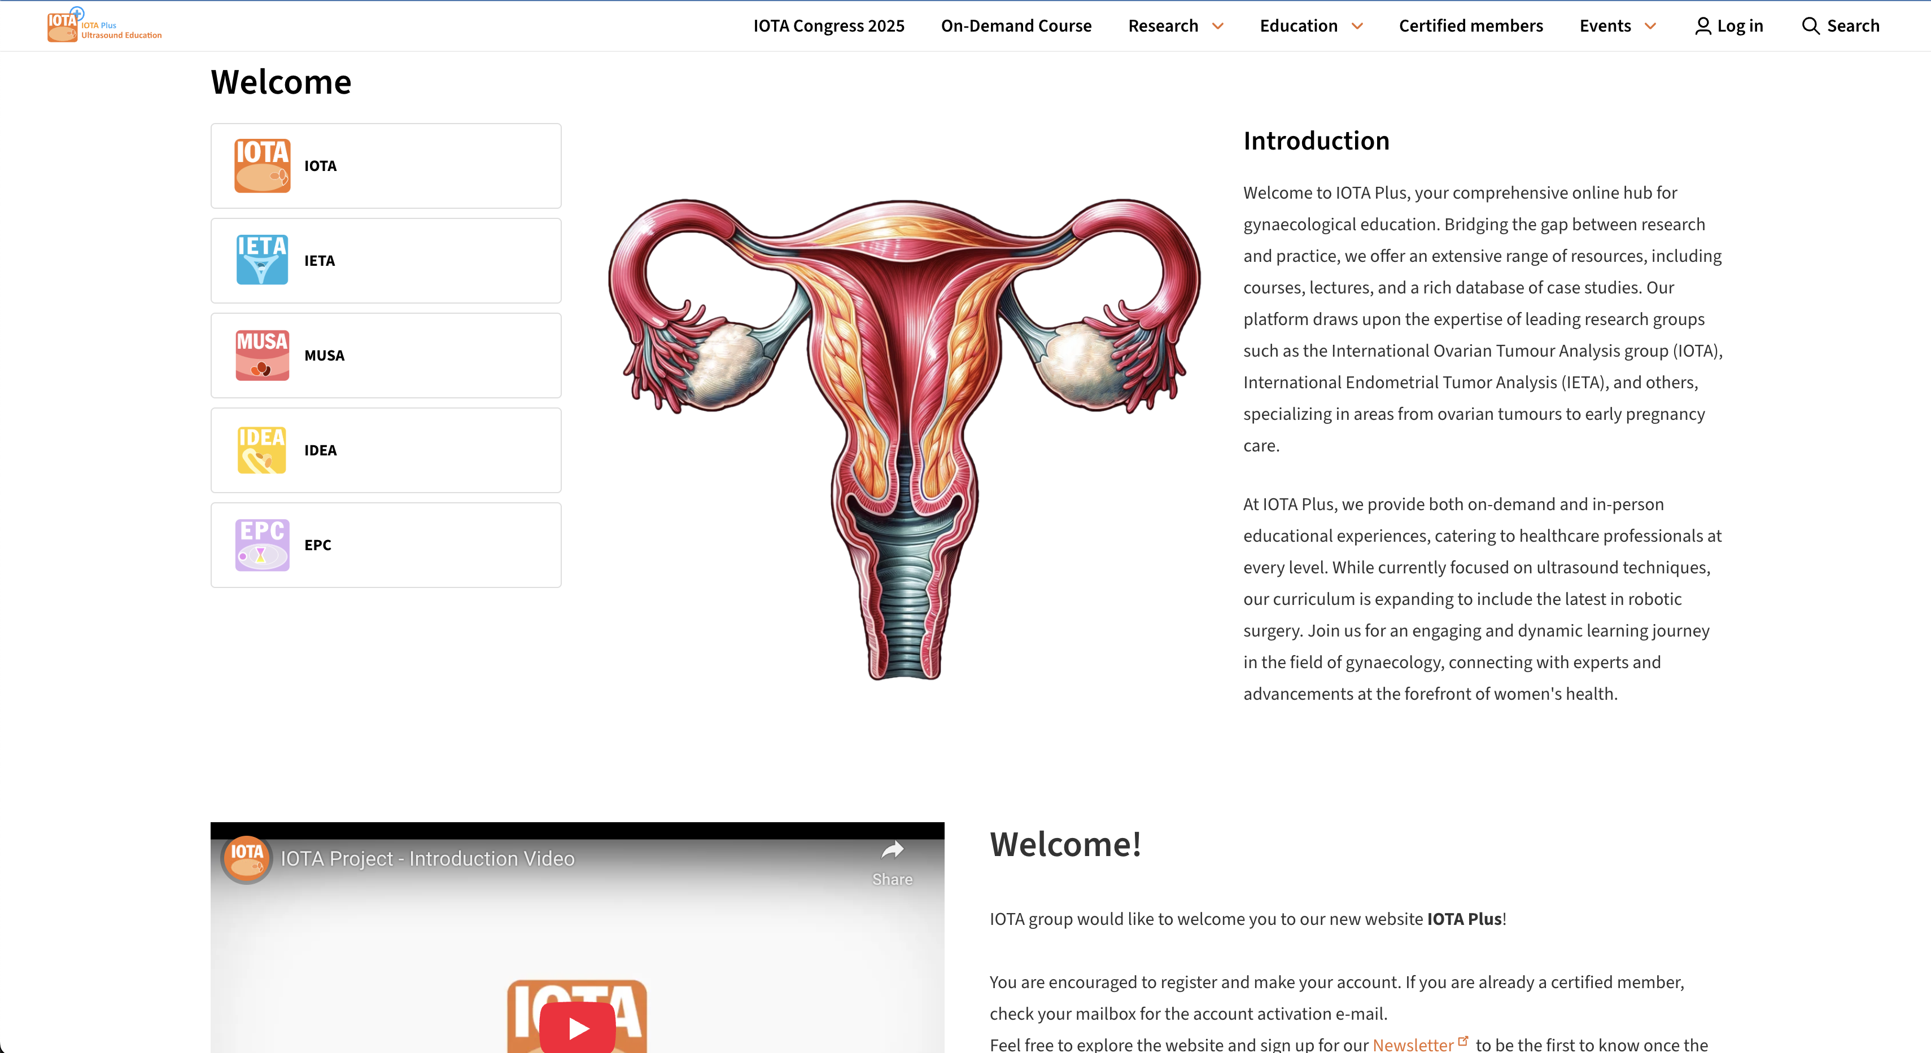
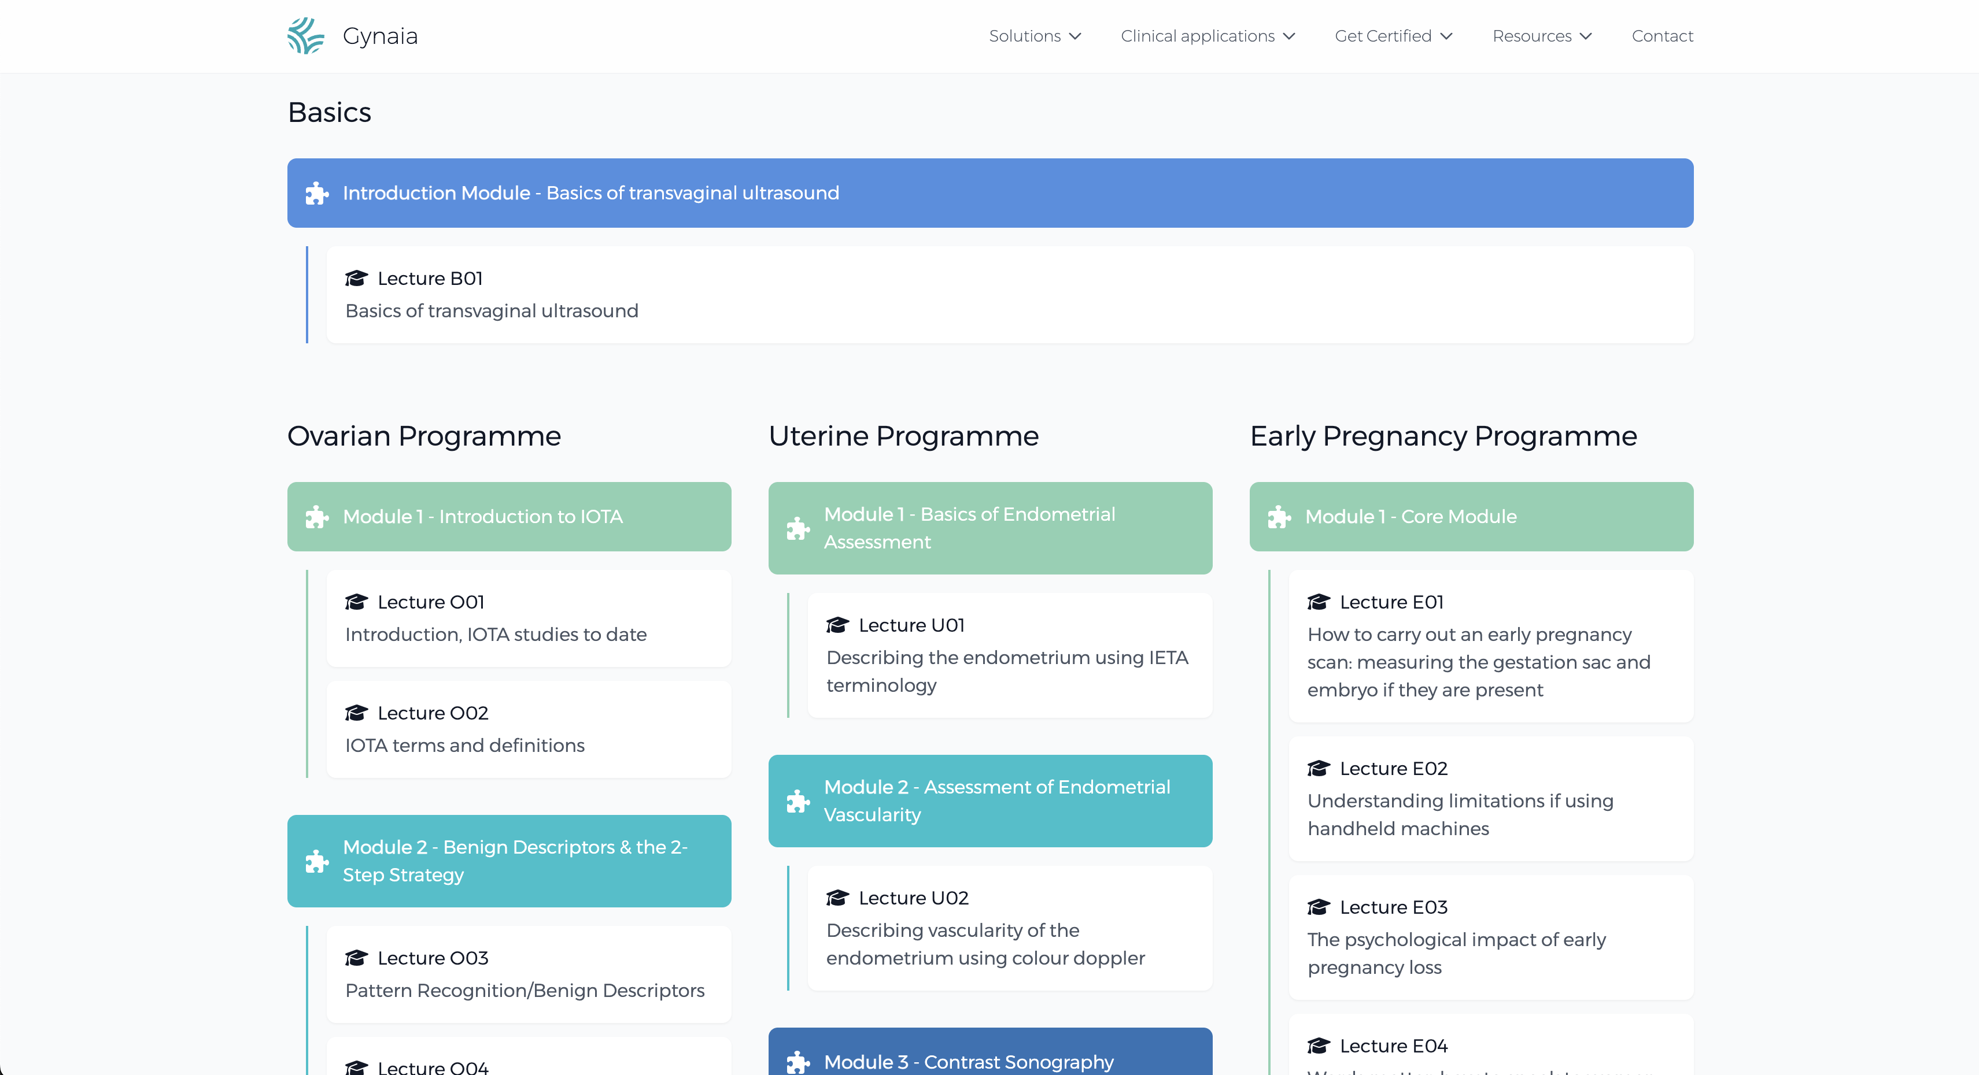
IOTA & Gynaia
Gynaia: IOTA Consortium & Leuven University spin-off
for member training & certification, continuous education, study support, & clinical decision support apps
→
←
🔍
→
←
🔍
www.iotaplus.org
www.gynaia.com
Notes:
Training and certification, continuous education:
Learning materials
Lectures
Case database
Webinars
Learning tools
Helpdesk for learners
Proficiency assessment and image qc
Portal
Learning management system
Clinical decision support:
Qc tools
Iota app
Ieta app
M6…
Study support:
Cdm
Data analysis
Research study support
Trial management support

Slide 21
IOTA Editorial Board
Clinical expertise, learning materials, exam questions, and passing grade levels

Slide 22
IOTA Editorial Board
Meet the Editorial Board
Ovarian pathology, Adnexal Masses, Endometrium/Myometrium pathology, Endometriosis, and Early Pregnancy
The IOTA Editorial Board operates independently from Gynaia and brings together leading clinicians, researchers, and educators in gynecological ultrasound. They ensure that every element of our training, certification, and continuous learning platform reflects the highest scientific and clinical standards.
The Board curates and updates all learning materials, reviews and selects educational clinical cases, and oversees the certification exams. They identify expert speakers, keep content current with emerging evidence, and integrate insights from both daily clinical practice and frontline research. Their collective expertise guarantees that the training & certification programmes across clinical application domains remain rigorous, relevant, and aligned with international terminology and best-practice guidelines.

Slide 23
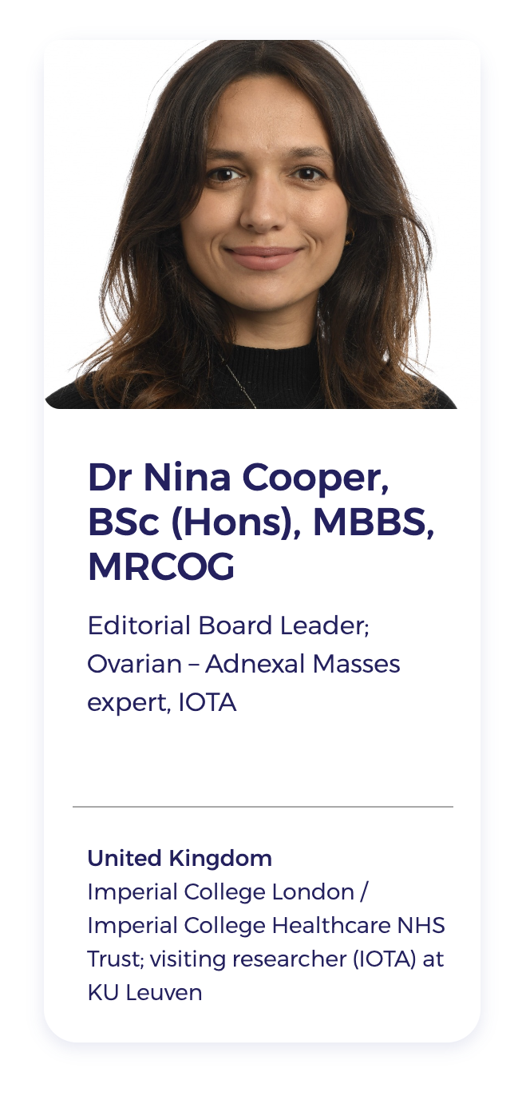
Board leader – Dr. Nina Cooper

Slide 24

Adnexal Masses / Ovarian Tumours

Slide 25
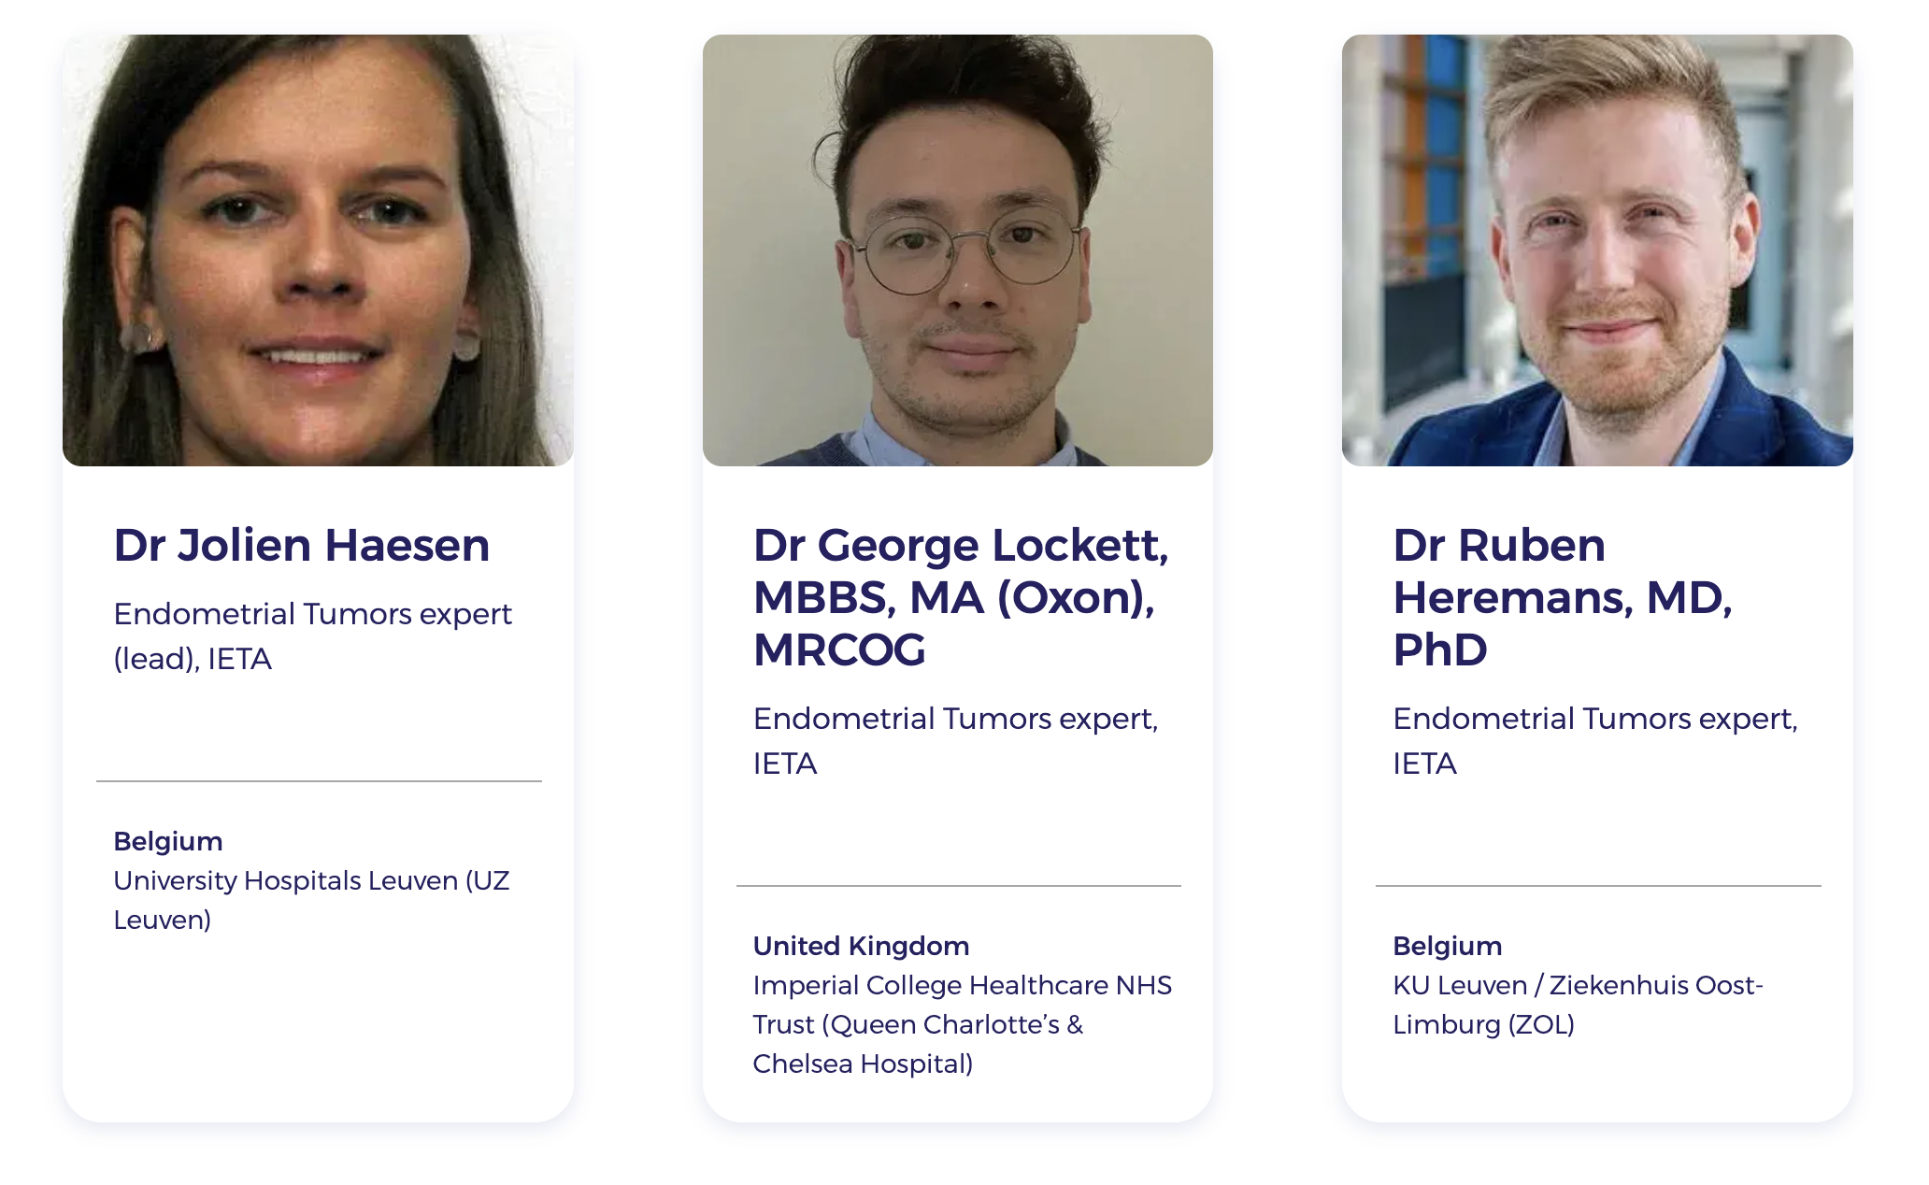
Endometrium pathologies

Slide 26
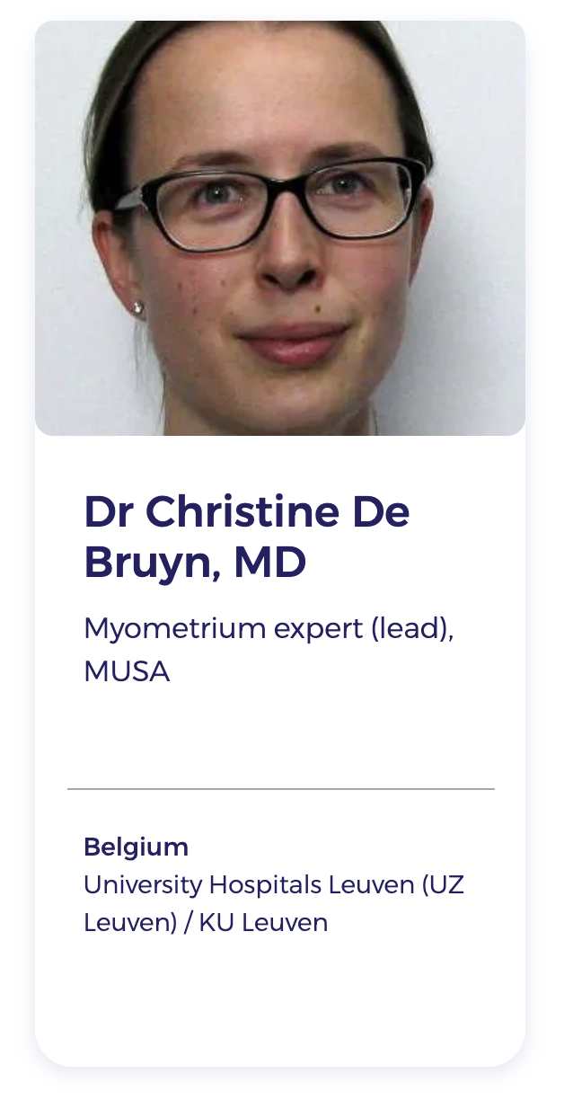
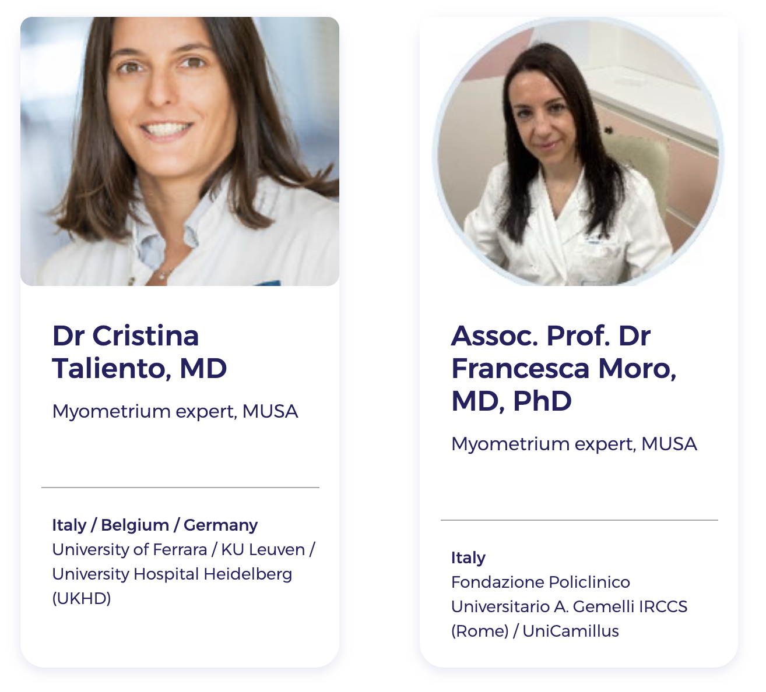
Myometrium pathologies

Slide 27
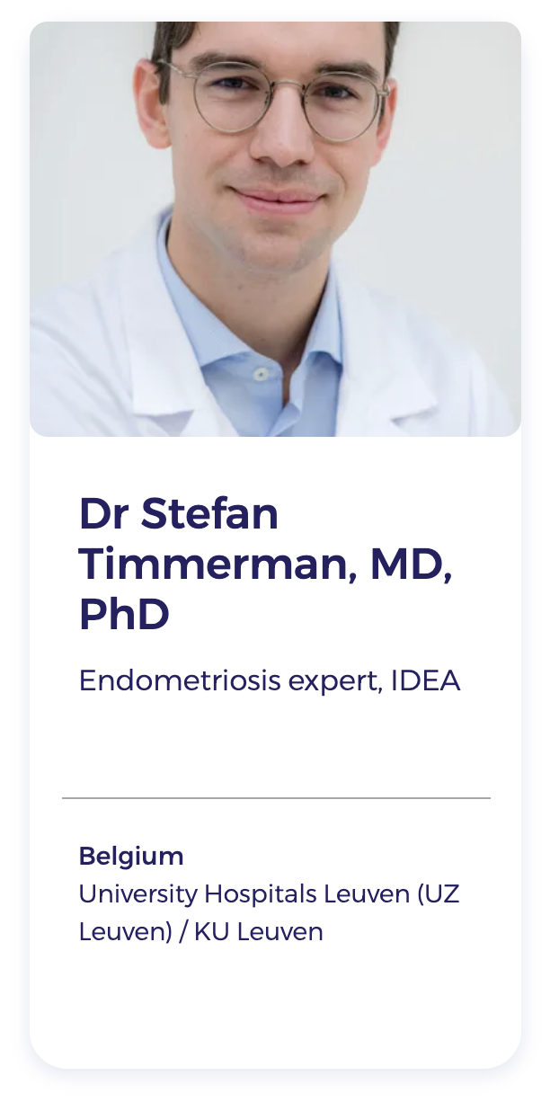
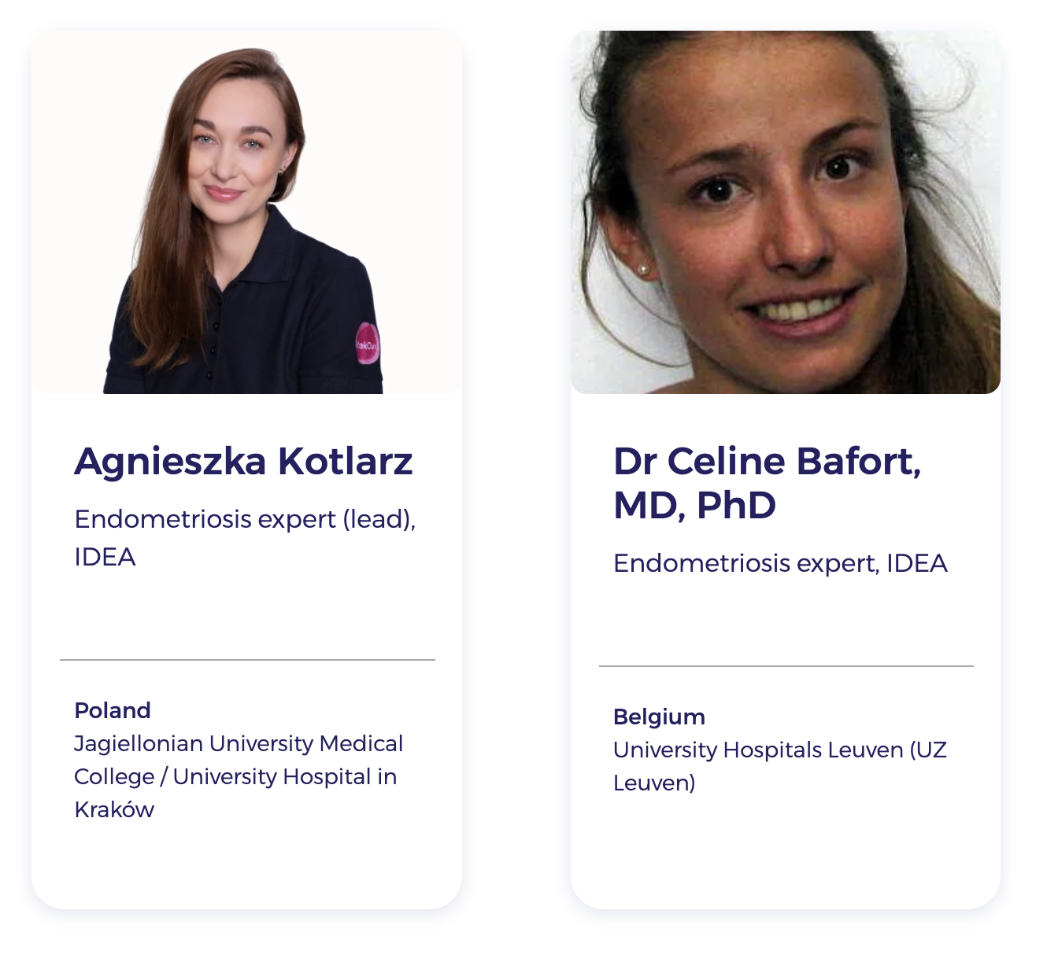
Endometriosis

Slide 28
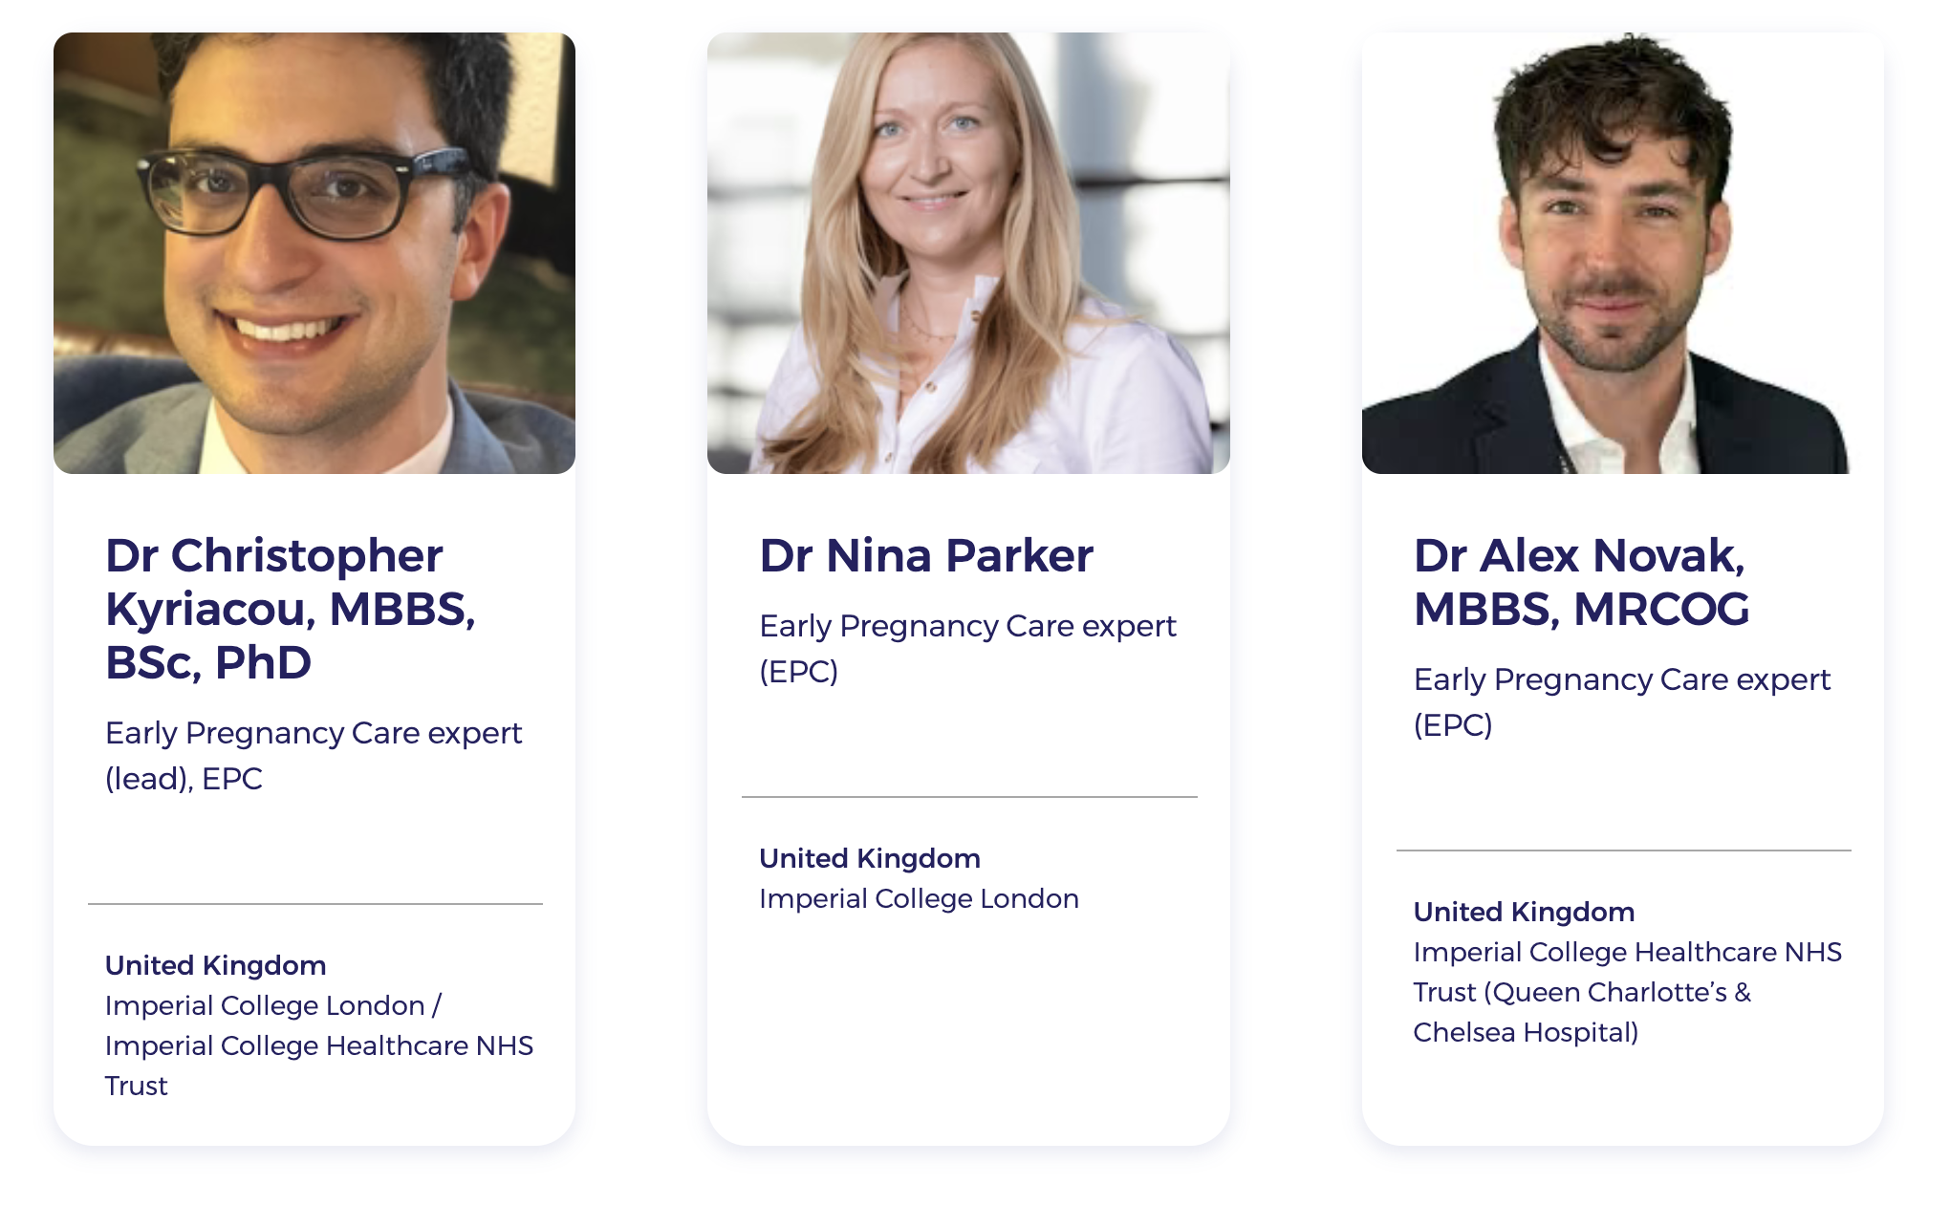
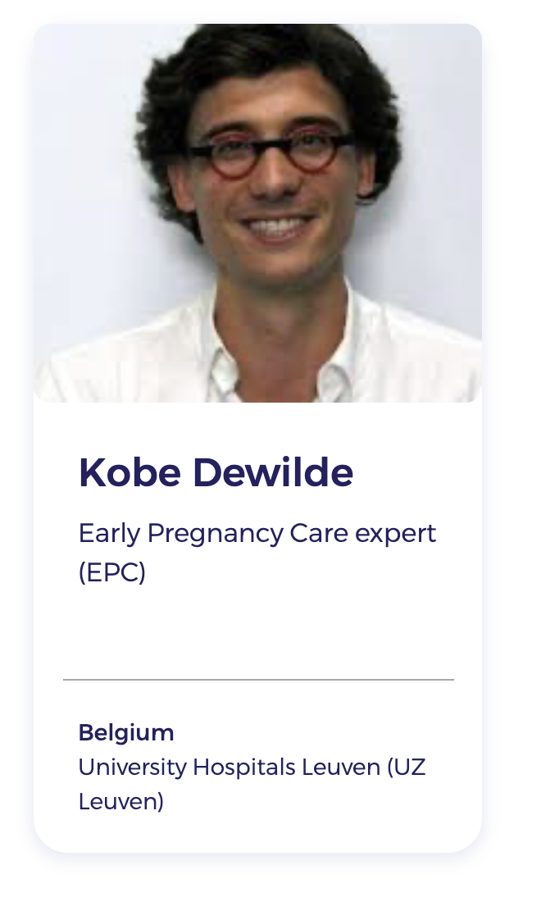
Early pregnancy care / Ectopic pregnancies

Slide 29
Gynaia & IOTA
IOTA consortium and Gynaia as spin-off

Slide 30











The EPC membership programme
Continuous, Online Learning
Meetings & Events
An LMS (learning management system) with rich course materials on Early Pregnancy Care.
Expert-led in-person seminars for interactive learning and discussion, stand-alone or linked to congresses.
Case database
Quality Assurance Program
Continuously growing set of interesting clinical cases for review.
QC submission and review to ensure high-quality interpretation, and report.
Certification
Access to ADNEX & model apps
Validate your expertise with the EPC certification exam.
Use compliant, robust web and phone apps in your practice. Phone, tablet, laptop, …
Professional support
Case stream webinars
Day-to-day support for apps & tools, training program, apps, and logistics.
Bimonthly webinars with case reviews by national and international experts

Slide 31
The EPC membership programme
Continuous, Online Learning
Meetings & Events
An LMS (learning management system) with rich course materials on Early Pregnancy Care.
Expert-led in-person seminars for interactive learning and discussion, stand-alone or linked to congresses.
Case database
Quality Assurance Program
Continuously growing set of interesting clinical cases for review.
QC submission and review to ensure high-quality interpretation, and report.
Certification
Access to M6 model as app
Validate your expertise with the EPC certification exam.
Use compliant, robust web and phone apps in your practice. Phone, tablet, laptop, …
Professional support
Case stream webinars
Day-to-day support for apps & tools, training program, apps, and logistics.
Bimonthly webinars with case reviews by national and international experts

Slide 32
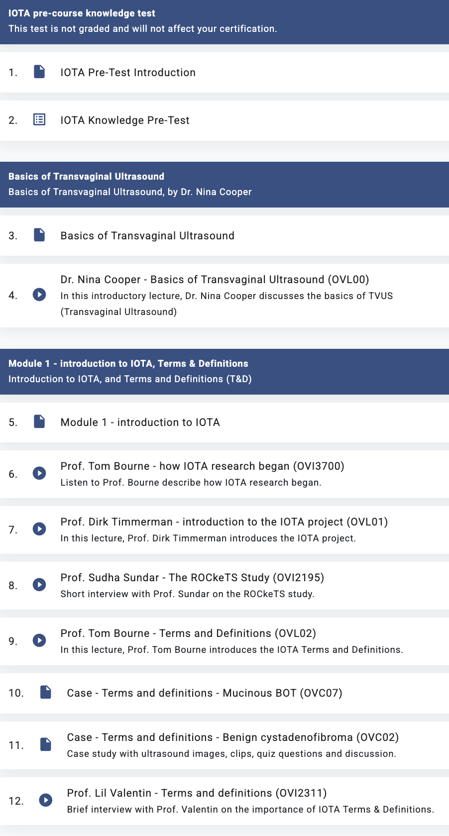
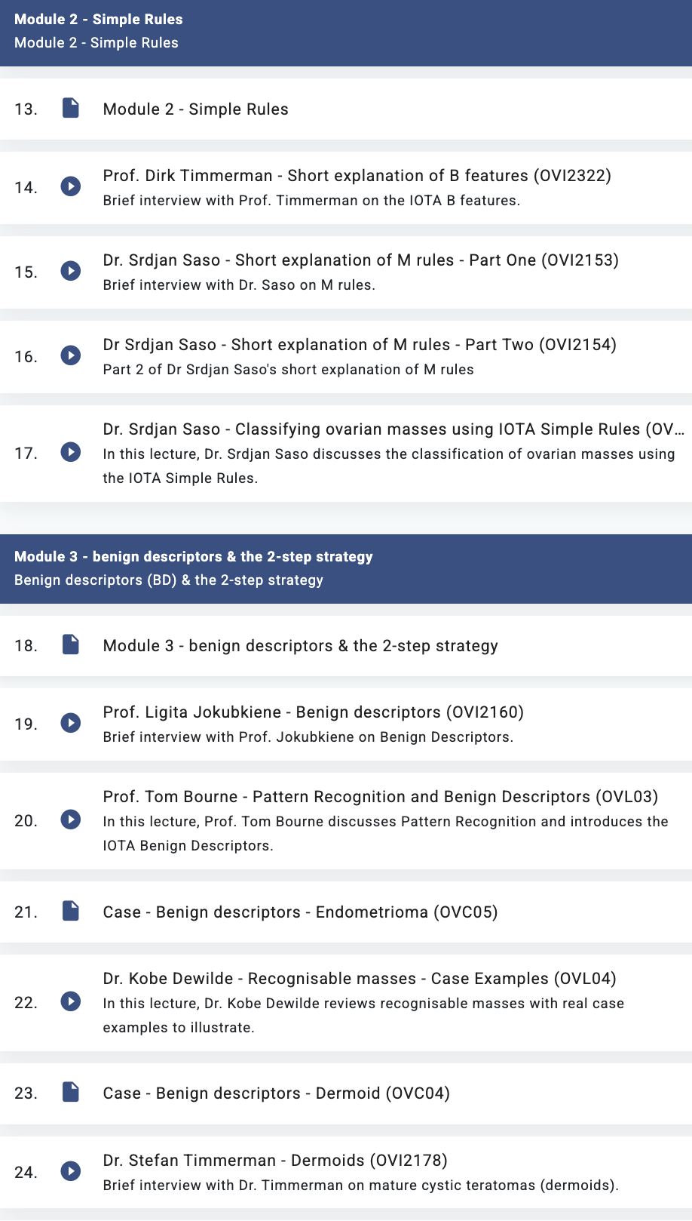
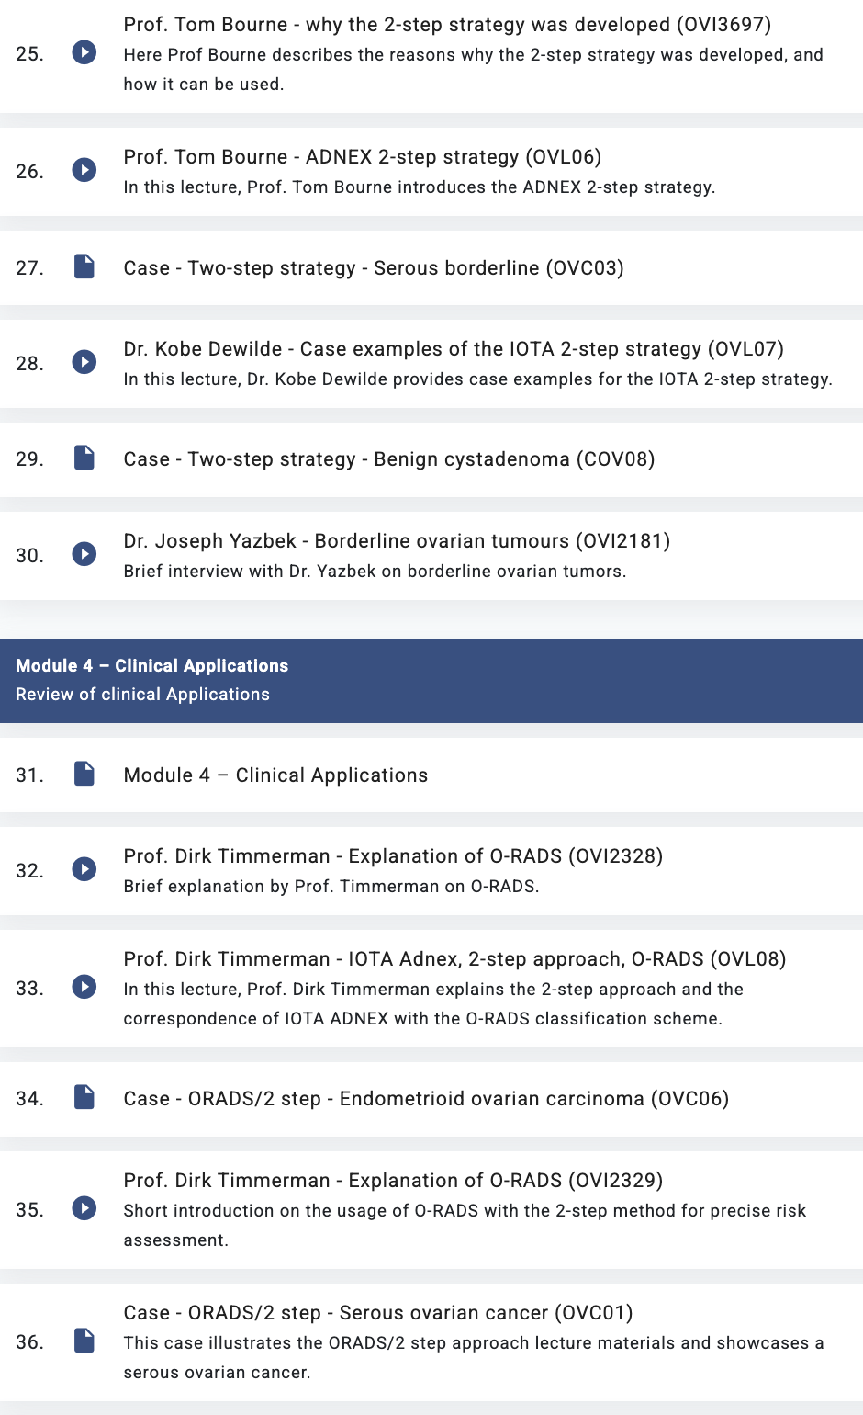
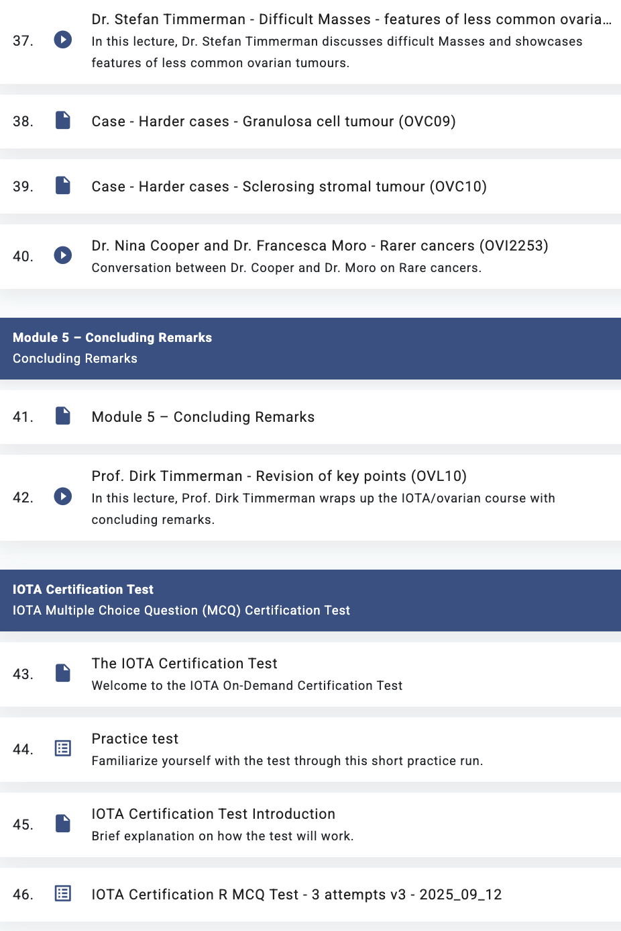
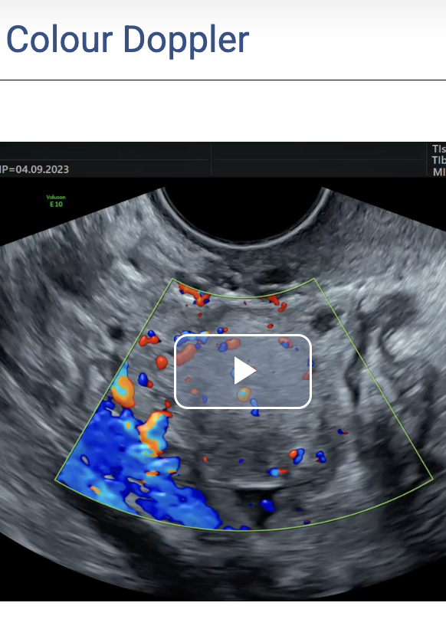
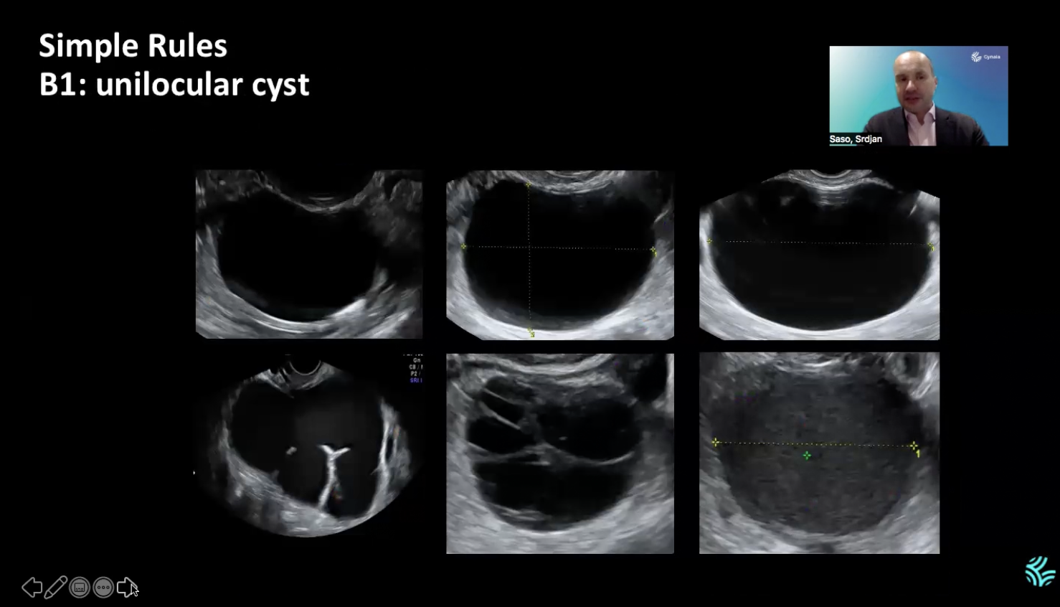
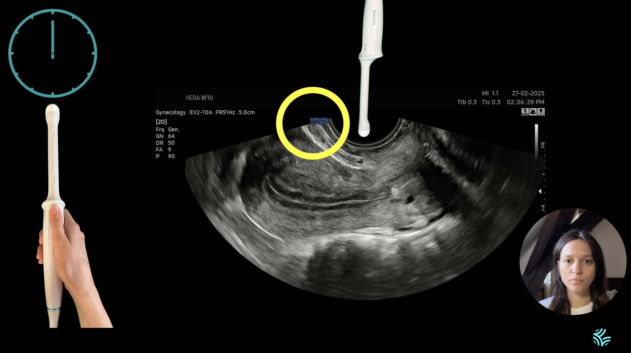
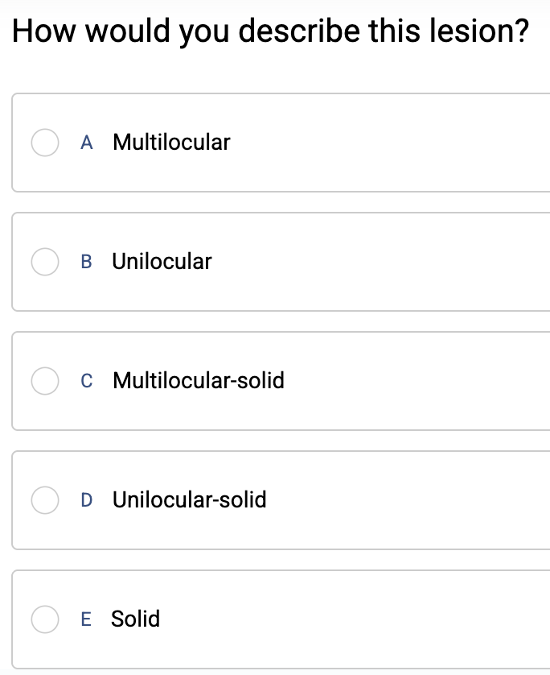
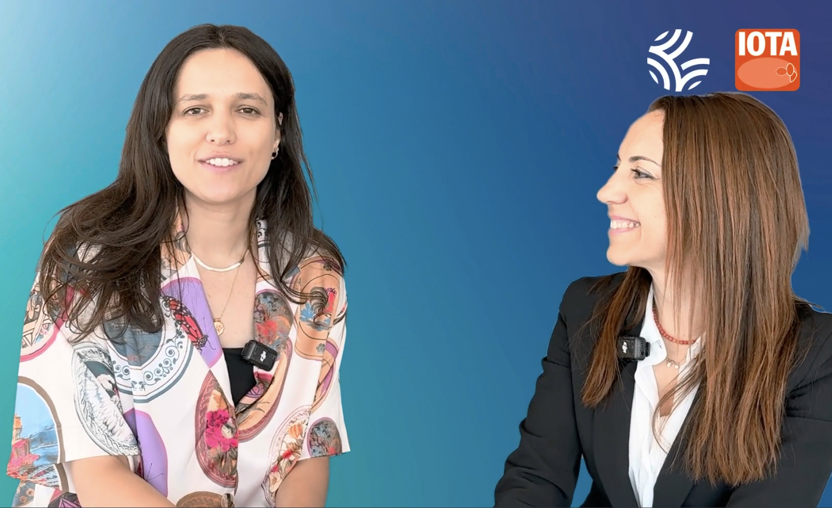
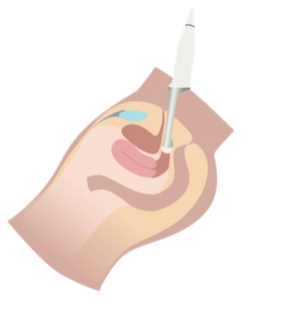
Thank you, Editorial Board members!

Slide 33
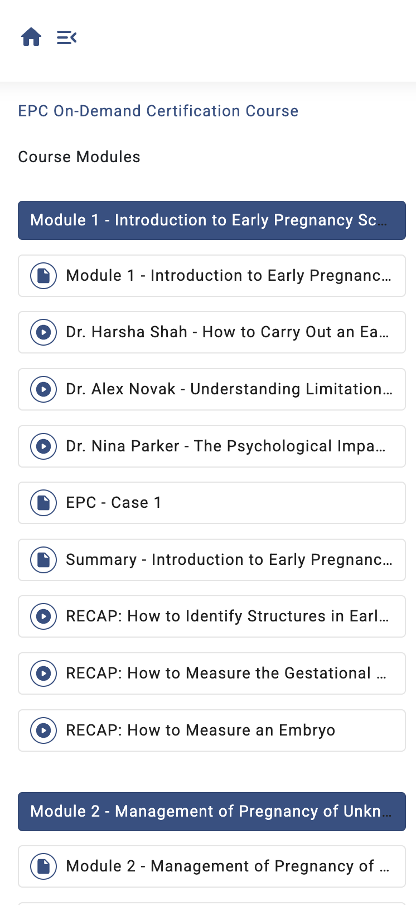
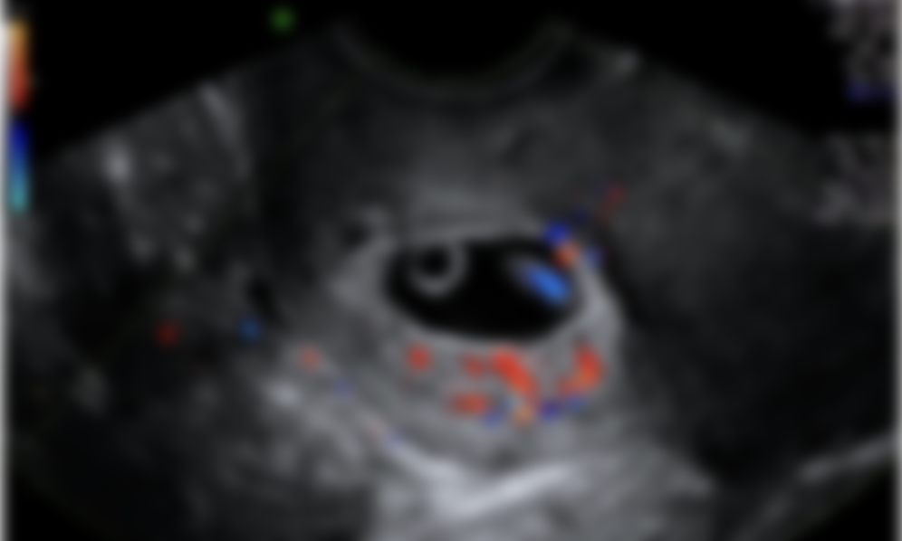
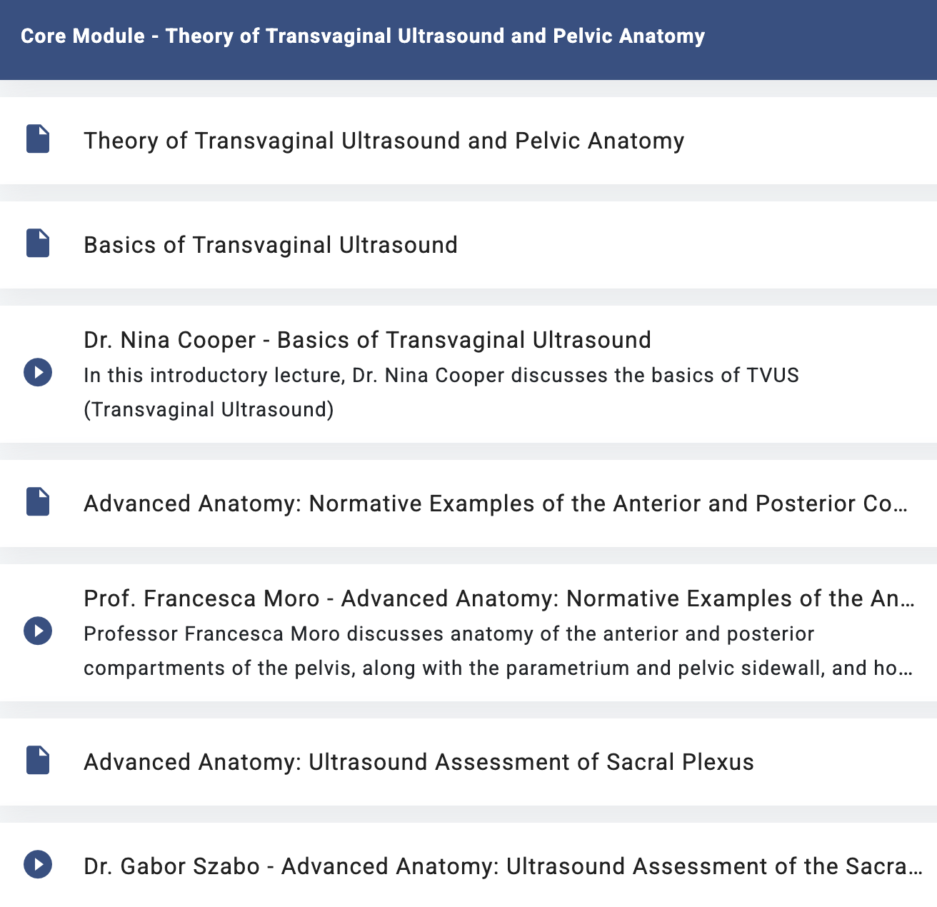
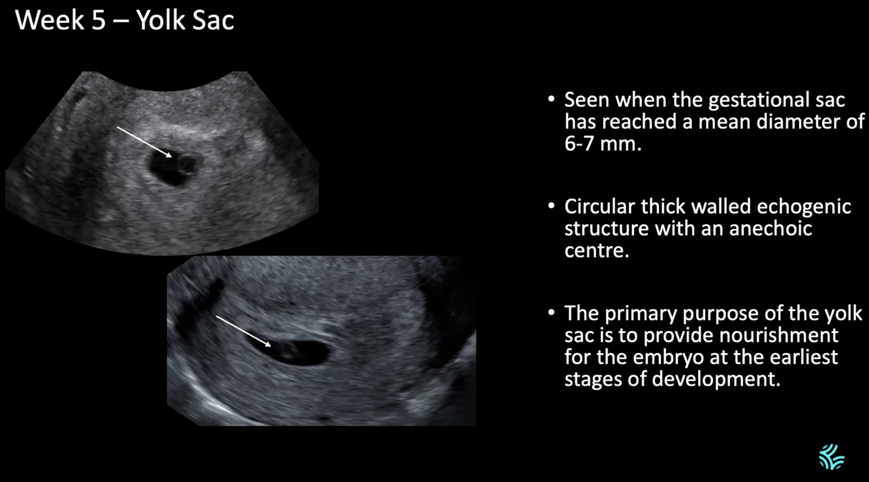

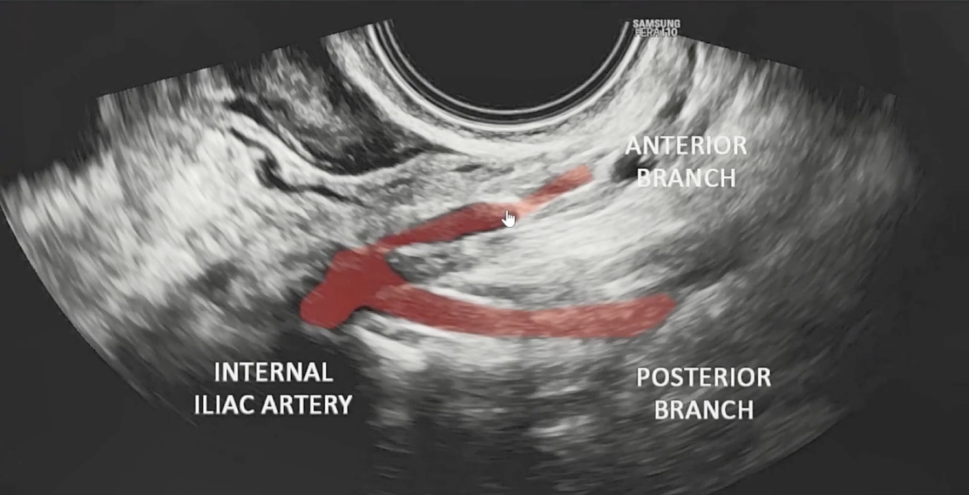
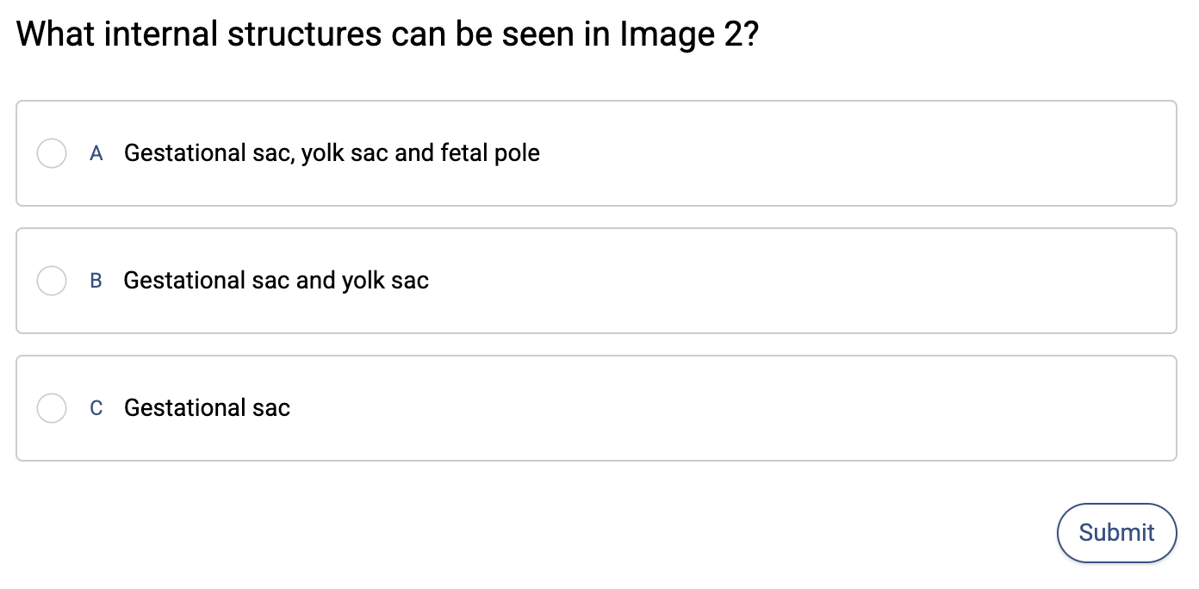
Cases
Lectures
Learning modules
Interviews
Quizzes
Visuals & Clips
Core Module - Theory of Transvaginal Ultrasound and Pelvic Anatomy
Module 1 - Introduction to Early Pregnancy Scanning
Module 2 - Management of Pregnancy of Unknown Location (PUL)
Module 3 - Assessing Viability and Diagnosing Miscarriage
Module 4 - Diagnosing and Managing Ectopic Pregnancy
EPC Certification Test

Slide 34
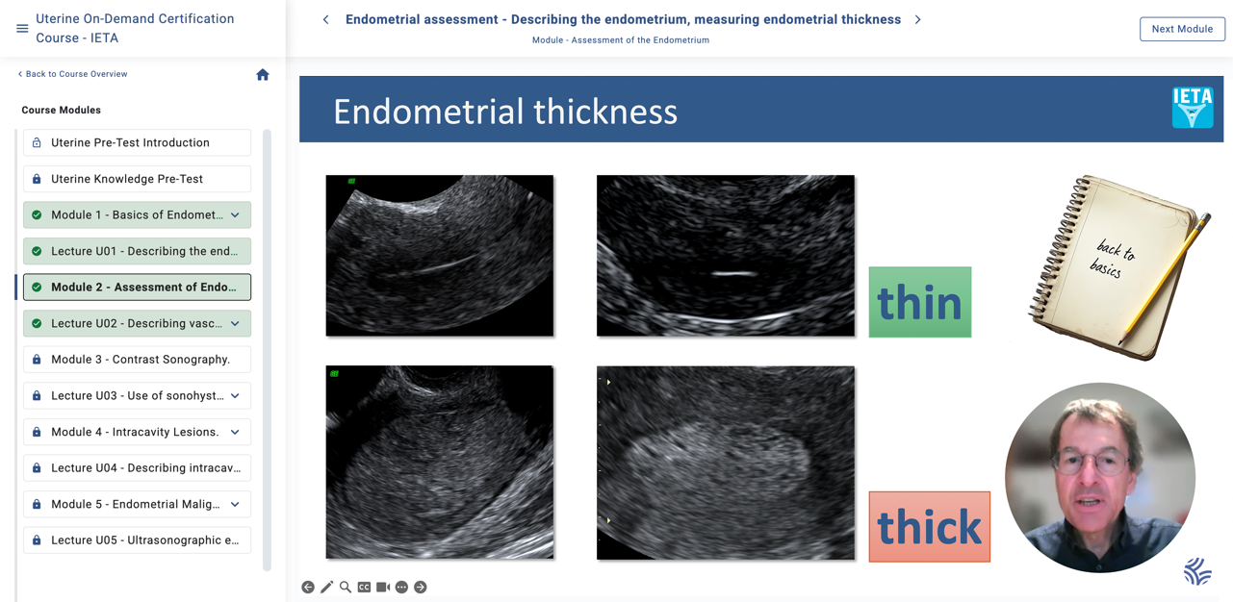


Slide 35
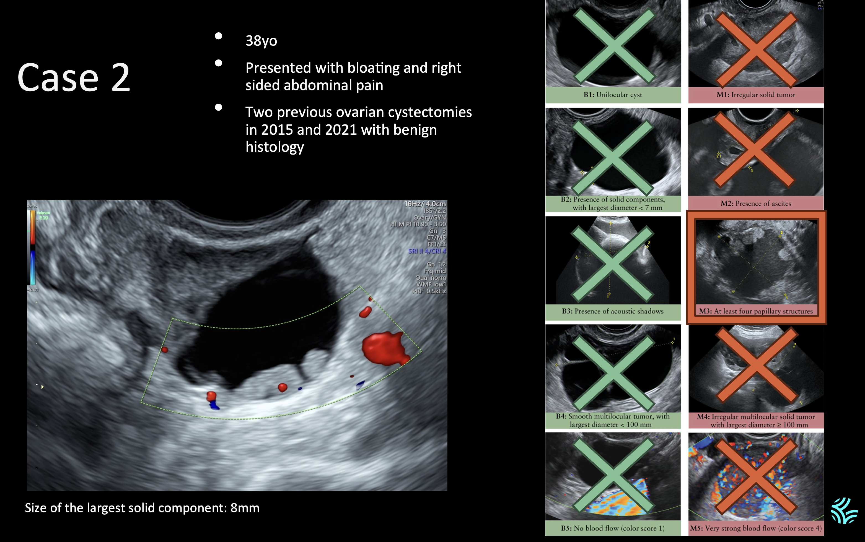

Slide 36
The EPC membership programme
Continuous, Online Learning
Meetings & Events
An LMS (learning management system) with rich course materials on Early Pregnancy Care.
Expert-led in-person seminars for interactive learning and discussion, stand-alone or linked to congresses.
Case database
Quality Assurance Program
Continuously growing set of interesting clinical cases for review.
QC submission and review to ensure high-quality interpretation, and report.
Certification
Access to M6 model as app
Validate your expertise with the EPC certification exam.
Use compliant, robust web and phone apps in your practice. Phone, tablet, laptop, …
Professional support
Case stream webinars
Day-to-day support for apps & tools, training program, apps, and logistics.
Bimonthly webinars with case reviews by national and international experts

Slide 37


Slide 38


Case database
Continuously growing set of interesting early pregnancy, uterine, ovarian, … educational cases for review.

Slide 40

Training programme components
Continuous Learning
Online & On-site Training
An LMS (learning management system) with rich course materials on ADNEX and beyond.
Expert-led sessions for interactive learning and discussion. Webinars, ‘office hours’, & in-person seminars.
Case database
Quality Assurance Program
Continuously growing set of interesting clinical cases for review.
QC submission and review to ensure high-quality interpretation, and report.
Certification
Access to ADNEX
Validate your expertise with the IOTA exam and recertify every 2 years.
Use compliant, robust web and phone apps in your practice.
Professional support
Case streams
Day-to-day support for apps & tools, training program, ADNEX, logistics.
Quarterly webinars with case reviews by national and international experts

Slide 41






Case Stream webinars
Webinars organized by IOTA consortium & Gynaia
  Every 2-3 months; case-based learning, expert case reviews
  Freely accessible for active IOTA ovarian programme members

Slide 42
The EPC membership programme
Continuous, Online Learning
Meetings & Events
An LMS (learning management system) with rich course materials on Early Pregnancy Care.
Expert-led in-person seminars for interactive learning and discussion, stand-alone or linked to congresses.
Case database
Quality Assurance Program
Continuously growing set of interesting clinical cases for review.
QC submission and review to ensure high-quality interpretation, and report.
Certification
Access to M6 model as app
Validate your expertise with the EPC certification exam.
Use compliant, robust web and phone apps in your practice. Phone, tablet, laptop, …
Professional support
Case stream webinars
Day-to-day support for apps & tools, training program, apps, and logistics.
Bimonthly webinars with case reviews by national and international experts

Slide 43


Access to ADNEX, IETA and M6 models
Use compliant, robust web and phone apps in your practice. Phone, tablet, PC, laptop…

Slide 44


Early Pregnancy – PUV/PUL/M6
Use compliant, robust web and phone apps in your practice. Phone, tablet, PC, laptop.

Slide 45
Learn more?
IOTA and Gynaia are rolling out the new ovarian, uterine and early pregnancy training & certification programmes, ADNEX app, case database, webinars, and much more.
Get in touch:
info@gynaia.com
www.gynaia.com
→
←
🔍
www.gynaia.com

Slide 46

Learn more at www.gynaia.com &
Become a Member

