Slide 1
Case title
IOTA – ddmmyy – final histology
Modify the title categories above and delete this sentence

Slide 2
General Info (remove this slide before submission)
Use the template in the following slides
Remember to remove patient identifiable data on every image and clip

Slide 3
Consent
Please confirm the following statements by adding an ‘x’ in the box:
(*) I confirm that there is no patient-identifiable information in the slides submitted and that I have obtained appropriate consent to share this case. I understand that if my case is selected for presentation, the Case Stream session will be recorded and made available online to registered Gynaia members.
(*) I would like my case to be included in the upcoming Gynaia Case Database, an educational and interactive online resource with real-world case examples
(*) I am willing to be contacted to provide additional details that could enhance the case and help develop it into a high-quality example for Case Stream and educational use.

Slide 4
Acknowledgments
Case provided by:
Name, Surname, Centre, Country

Slide 5
Patient Information
Age:
Menopause: yes/no
Parity:
Symptoms:
Relevant past medical history (including gyn surgeries):
Oncological centre: yes/no

Slide 6
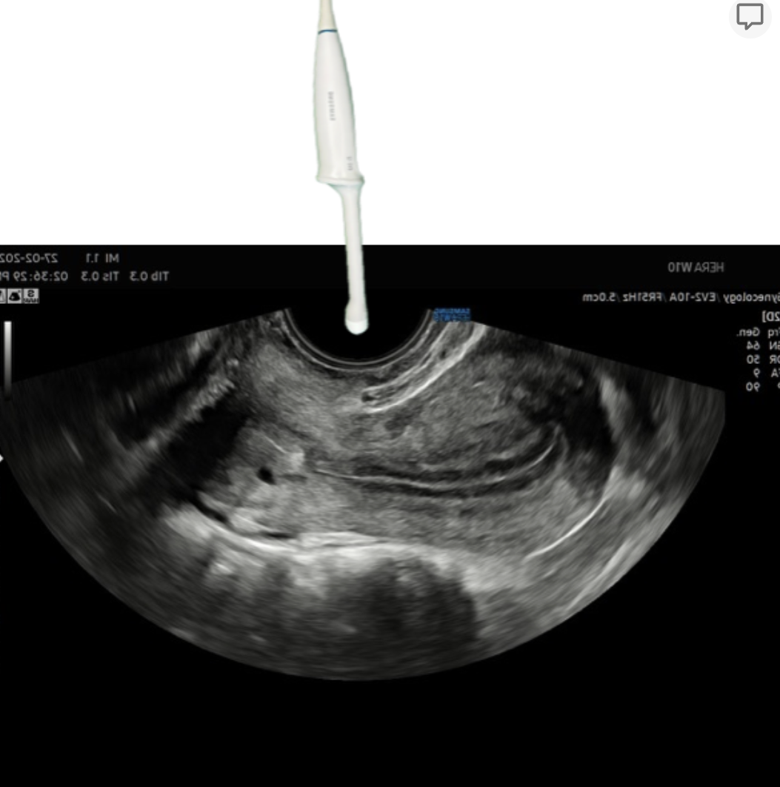
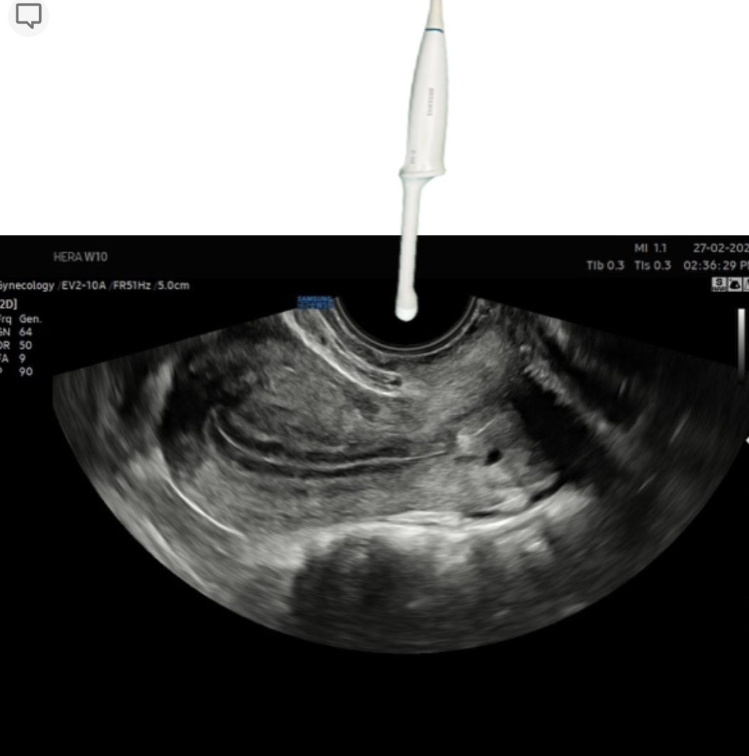
Machine Settings (check box or add a different setting)

Slide 7
Video Clip - 2D Scan Throughout the Lesion
Please include anonymized video

Slide 8
Video Clip 2 – Vascularization
Please include anonymized video
Please include only video(s) with correctly set PRF

Slide 9
Images – Ultrasound Features 2D
Show all three dimensions of the lesion with measurements on screen
Show all three dimensions of the solid component(s) with measurements on screen
(if present)

Slide 10
Images – Ultrasound Features Doppler
Show Color Doppler of the whole lesion
Show Color Doppler of the solid component(s)
(if present)
Please only include images with correctly set PRF

Slide 11
Images – Additional Ultrasound Tools
3D Imaging (Render, TUI, Multiplanar, 3D Doppler...)
if available
Otherwise remove this slide

Slide 12
Images – Supplementary Images
Omental cake, Douglas, lymph nodes, etc…
If applicable or available
Otherwise remove this slide

Slide 13
Type of lesion (morphology)
This lesion is:
Unilocular
Multilocular
Unilocular-solid
Multilocular-solid
Solid

Slide 14
Two Step Strategy: Step 1 (Benign Descriptors)
Can you apply the modified Benign Descriptors?
Yes
No
If yes, which one?
BD1
BD2
BD3
BD4

Slide 15
Two Step Strategy: Step 2 (IOTA ADNEX) (1)
Insert ADNEX variables

Slide 16
Two Step Strategy: Step 2 (IOTA ADNEX) (2)
Insert ADNEX Results (Relative Risk Plot - screenshot)

Slide 17
Management
Specify the management

Slide 18
Case Outcome
Macroscopy image (gross section)
We highly recommend to include macroscopy, if applicable.

Slide 19
Case Outcome
Specify the final histology

Slide 20
Case relevance
Why is this case relevant? (check one or more)
Very didactic (typical features)
Special outcome (atypical features)
Special ultrasound images
Other…

Slide 21
Literature
Drop here references of the main publications on the topic (URLs):

