Slide 1
Myoma/Sarcoma MUSA Date: day/month/year

Slide 2
General Info (remove this slide before submission)
Use the template in the following slides
Remember to remove patient identifiable data on every image and clip

Slide 3

Consent
Please confirm the following statements by adding an ‘v’ in the box:
(*) I confirm that there is no patient-identifiable information in the slides submitted and that I have obtained appropriate consent to share this case. I understand that if my case is selected for presentation, the Case Stream session will be recorded and made available online to registered Gynaia members.
(*) I would like my case to be included in the upcoming Gynaia Case Database, an educational and interactive online resource with real-world case examples
(*) I am willing to be contacted to provide additional details that could enhance the case and help develop it into a high-quality example for Case Stream and educational use.

Slide 4


Acknowledgments
Case provided by:
Name and Surname
Institution, City, County

Slide 5

Patient Information
AGE
MENOPAUSE
PARITY
SYMPTOMS
MEDICAL HISTORY
ONCOLOGICAL CENTER
XX years old
Yes/No
…
…
…
Yes/No

Slide 6
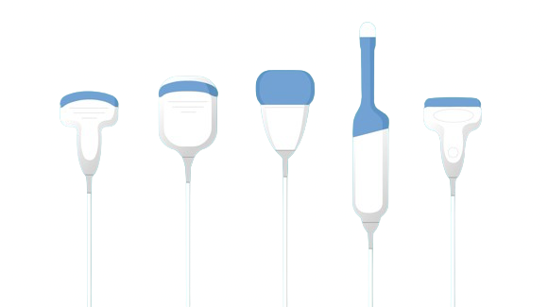

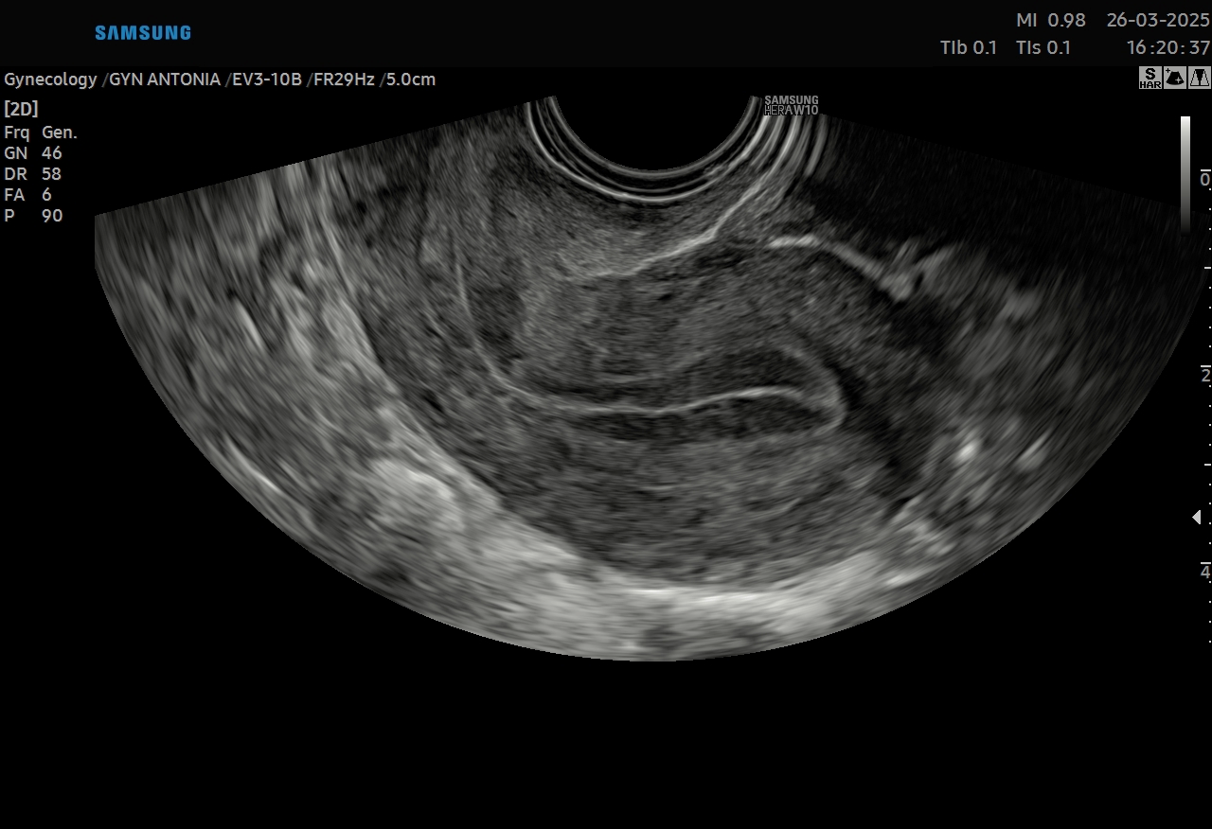
Machine Settings (check box or add a different setting)

Slide 7
Video Clip – 2D Scan Throughout the Lesion
Show an anonymized grayscale video demonstrating the uterus, endometrium, and myometrial lesion(s).

Slide 8
Video Clip 2 – Vascularization
Show an anonymized Color Doppler video of the myometrial lesion.
Please include only videos with correctly set PRF.

Slide 9
Images – Ultrasound Features 2D
Show anonymized grayscale images with three measured diameters of the target myometrial lesion.

Slide 10
Images – Ultrasound Features Doppler
Show an anonymized Color Doppler image of the lesion.
Please only include images with correctly set PRF.

Slide 11
Images – Additional Ultrasound Tools
Show 3D Imaging (Render, TUI, Multiplanar, 3D Doppler...)
if available
Otherwise remove this slide

Slide 12
Images – Supplementary Images
Show additional images or videoclips of the ovaries, pouch of Douglas, lymph nodes, and other relevant structures, if applicable or available.
Otherwise remove this slide.

Slide 13
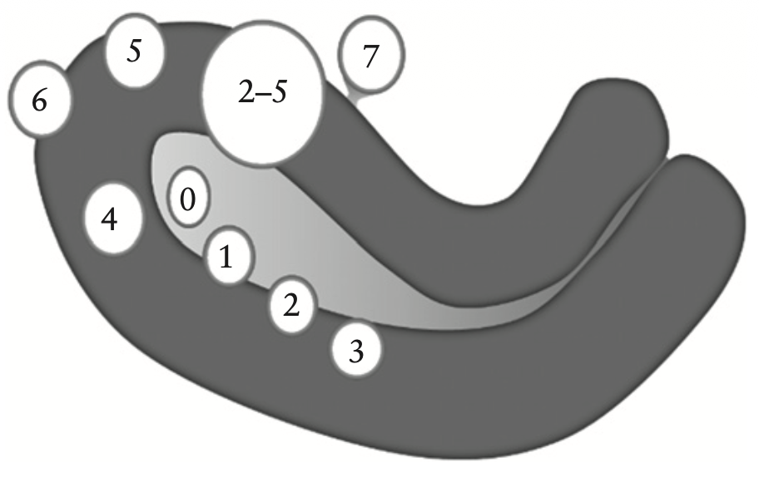
Ultrasound features of lesion
Show an anonymized grayscale image of the myometrial lesion showing the location and site
MUSA characteristics
Number =…
Location = …
Site = …
Size = … mm

Slide 14
Ultrasound features of lesion
How would you describe the ECHOGENICITY of the lesion?
Hypoechogenic
Mixed
Uniform, hypoechogenic
Non-uniform, mixed
Non-uniform, echogenic areas
Non-uniform, cystic areas
Isoechogenic
Echogenic areas
Hyperechogenic
Cystic areas

Slide 15
Ultrasound features of lesion
MUSA characteristics
Echogenicity = …
Show an anonymized grayscale image of the myometrial lesion showing the echogenicity

Slide 16
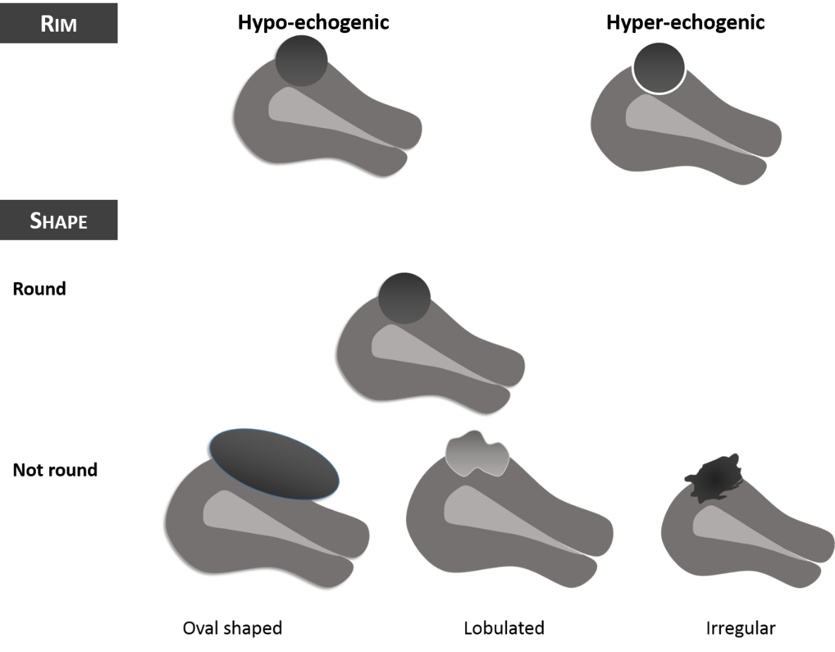
Ultrasound features of lesion
How would you describe the RIM of the lesion?
HYPOECHOGENIC
HYPERECHOGENIC
Hypoechogenic
Hyperechogenic
Ill-defined

Slide 17
Ultrasound features of lesion
MUSA characteristics
Echogenicity = …
Show an anonymized grayscale image of the myometrial lesion showing the rim
Rim = ….

Slide 18
Ultrasound features of lesion
ROUND
How would you describe the SHAPE of the lesion?
Round
Not-round, oval-shaped
Not-round, lobulated
Not-round, irregular
NOT-ROUND
Oval -shaped
Lobulated
Irregular

Slide 19
Ultrasound features of lesion
MUSA characteristics
Echogenicity = …
Show an anonymized grayscale image of the myometrial lesion showing the shape
Rim = …
Shape = …

Slide 20
Ultrasound features of lesion
Edge shadowing
How would you describe the ECHOGENICITY of the lesion?
Edge shadowing
Internal shadowing
Fan–shaped shadowing
Internal shadowing
Fan-shaped shadowing

Slide 21
Ultrasound features of lesion
MUSA characteristics
Echogenicity = …
Show an anonymized grayscale image of the myometrial lesion showing the type of shadowing (if present)
Rim = …
Shape = …
Shadowing = …

Slide 22
Ultrasound features of lesion
How would you describe the CYSTIC AREAS of the lesion?
Regular, anechoic
Regular, low-level
Irregular, anechoic
Irregular, low-level

Slide 23
Ultrasound features of lesion
MUSA characteristics
Echogenicity = non-uniform, cystic areas
Show an anonymized grayscale image of the myometrial lesion showing the cyst areas (if present)
Rim = ill-defined
Shape = round
Shadowing = fan-shaped
Cysts = present, irregular, anechoic

Slide 24
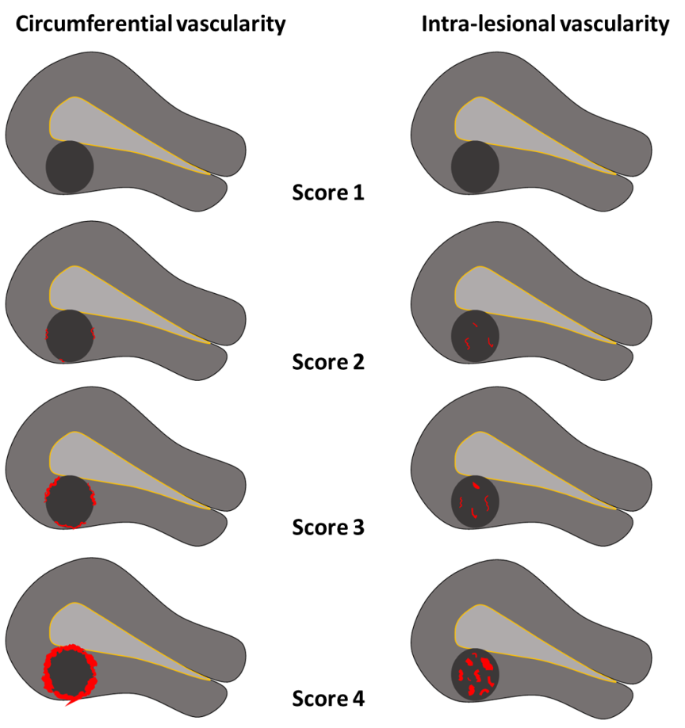
Ultrasound features of lesion
How would you describe the VASCULARIZATION of the lesion?
Absent (Color score 1)
Minimal (Color score 2)
Moderate (Color score 3)
Abundant (Color score 4)

Slide 25
Ultrasound features of lesion
MUSA characteristics
Amount of color = …
Show an anonymized Color Doppler image of the myometrial lesion

Slide 26
Ultrasound features of lesion
How would you describe the PATTERN OF VASCULARIZATION of the lesion?
Circumferential
Intralesional
Both

Slide 27
Ultrasound features of lesion
MUSA characteristics
Amount of color = …
Pattern =
Circumferential
Intralesional
Show an anonymized Color Doppler image of the myometrial lesion

Slide 28
Subjective assessment
Age ...
Postmenopausal status…
Symptoms…
Dimensions…
Echogenicity…
Rim…
Shape…
Shadowing…
Vascularization…
What is your suspected diagnosis?
Typical Leiomyoma
Atypical Leiomyoma
Leiomyosarcoma
Notes:
Age: … Postmenopausal status: … Symptoms: … Dimensions: … Echogenicity: … Rim: … Shape: … Shadowing: … Vascularization: …

Slide 29

Management
Surgery/follow up…
…
Notes:
Surgery or follow up

Slide 30
Case Outcome
Macroscopic image

Slide 31

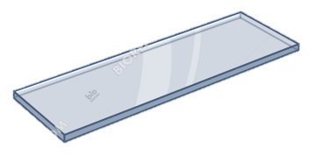

Case Outcome
Histology, slide (if available)
Final Histology
….

Slide 32
Case relevance
Why is this case relevant? (check one or more)
Very didactic (typical features)
Special outcome (atypical features)
Special ultrasound images
Other…

Slide 33
Literature

Slide 34
Literature

